Slide 1

WAVES

Slide 2
Energy is transferred through a wave
Mechanical waves- a disturbance in matter that transfers energy from place to place
energy of a mechanical wave can travel only through matter.
  Called the medium (plural, media); can be any state of matter
  particles of matter in the medium don’t travel along with the wave. Only the energy travels. The particles of the medium just vibrate

Slide 3
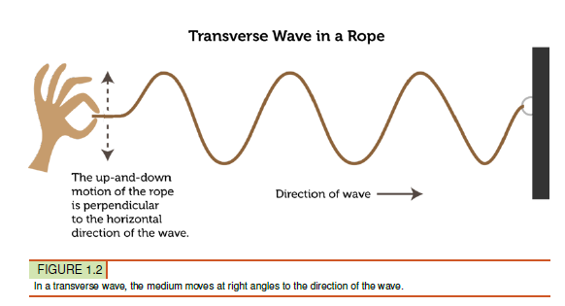
Types of Mechanical Waves
TRANSVERSE WAVES
The motion of the medium is perpendicular to the motion of the wave

Slide 4
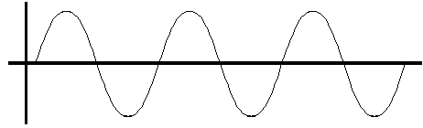
Crest & Trough of a Transverse Wave
Crest = High Point
Trough = Low Point

Slide 5

Example of Transverse Waves
S (Secondary) Waves – occur during an earthquake
  result of a sudden release of energy in the Earth's crust that creates seismic waves

Slide 6
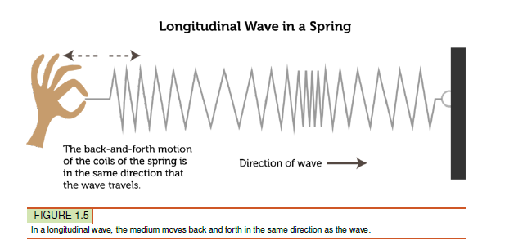
Types of Mechanical Waves
LONGITUDINAL WAVES
the medium vibrates in the same direction (is parallel) that the wave travels

Slide 7
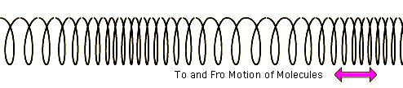
Compression & Rarefaction of a Longitudinal Wave
Compressions = particles of matter crowded together
Rarefactions = particles of matter spread apart

Slide 8
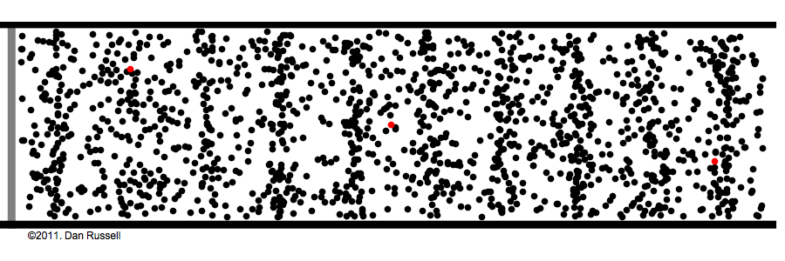
Example of Longitudinal Waves
P (Primary Waves) – occur during an earthquake
Sound Waves

Slide 9
Mechanical Waves

Slide 10

Surface Waves:
Transverse & Longitudinal Waves Combined

Slide 11
Measuring WAVES

Slide 12
Waves have properties (characteristics)
AMPLITUDE – Height of a wave (measured in decibels)
  maximum distance the particles of a medium move from their resting position when a wave passes through
  For Transverse waves = the height of each crest above the resting position; The higher the crests = greater amplitude
  For longitudinal wave = measure of how compressed particles of the medium become when the wave passes through; Closer together the particles are = greater the amplitude

Slide 13
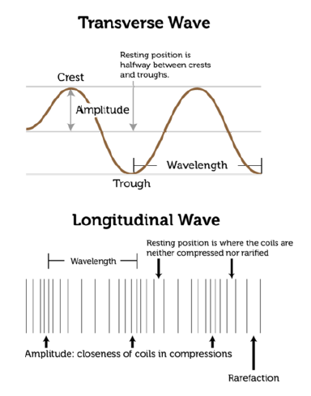

Slide 14
Waves have properties (characteristics)
WAVELENGTH –
distance between two corresponding points on adjacent waves
  For Transverse Waves = measured as the distance between two adjacent crests
For Longitudinal Waves = measured as the distance between two adjacent compressions
usually measured in meters
related to the energy of a wave. Short-wavelength waves have more energy than long-wavelength waves of the same amplitude

Slide 15
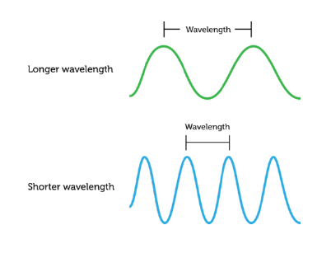

Slide 16
Waves have properties (characteristics)
FREQUENCY
The number of waves that pass a fixed point in a certain amount of time
For Transverse Waves = can be measured by counting the # of crests that pass a point in a certain time
For Longitudinal Waves = can be measured by counting the # of compressions that pass a point in a certain time

Slide 17
  FREQUENCY DETERMINES PITCH
    Think about someone’s singing voice
  As frequency increases, pitch gets higher
  As frequency decreases, pitch gets lower
  Measured in Hertz

Slide 18
HIGH PITCH
LOW PITCH

Slide 20
What can you hear?
Decibels (dB): Volume
Normal Speech: 60dB
Library: 40dB
Close Whisper: 20dB
Jet Engine: 140dB
Loud Rock Music: 110dB
Subway Train: 100dB
Busy Street Traffic: 70dB
120dB or above usually causes pain to the ear
Hertz (Hz): Pitch
Young people can hear frequencies between 20-20,000 Hz
Dogs can hear frequencies that range from 67-45,000 Hz
As you age, your ability to hear high frequency sound decreases.

