Slide 1
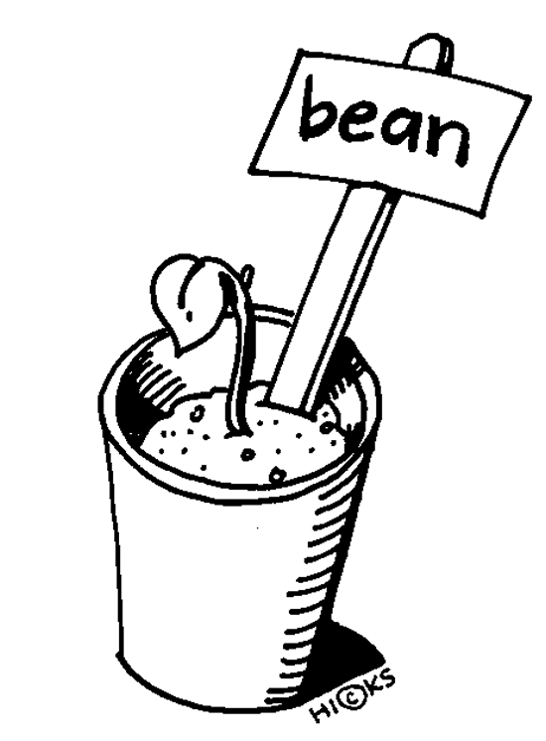
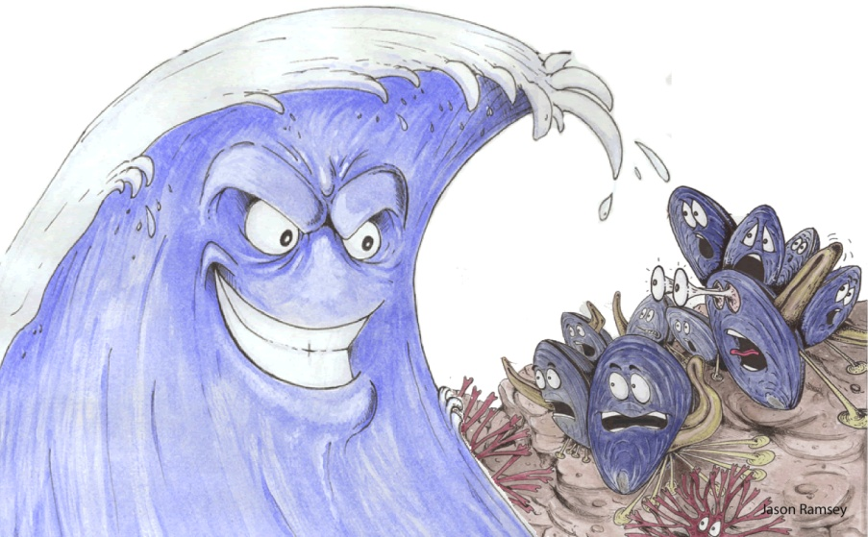
Environmental factors
and
TROPISM

Slide 2
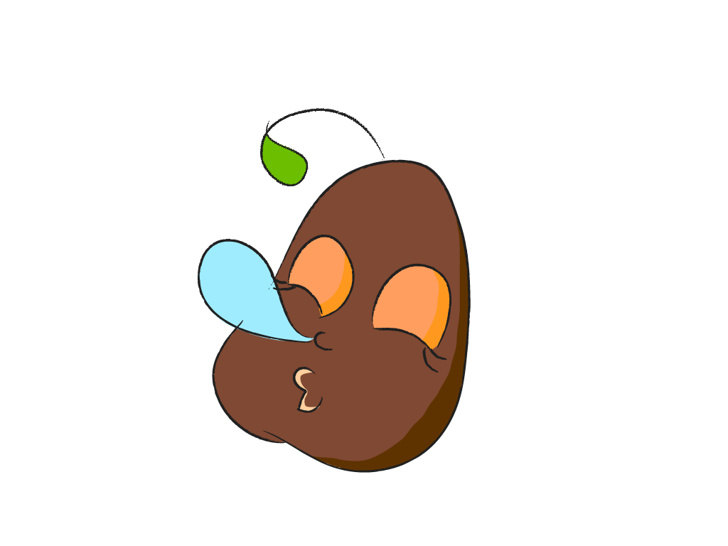
Dormancy
A period of inactivity in a mature seed before it begins to grow
  It’s like the seed is in a “sleep-state”
  Remains dormant until conditions are right for growth and development of the new plant.

Slide 3
Changes in the Environment
can affect the survival of individual organisms and entire species
  These changes are called external factors
    Examples are light intensity, day length, gravity, and temperature.

Slide 4
TROPISM
Plant growth or turning in response to an environmental stimulus
(“tropo” – ”turn”)
.
There are many types of tropisms :
  Phototropism
  Geotropism
  Thigmotropism
  Hydrotropism
  Chemotropism
  Thermotropism
3 main types
NEXT

Slide 5
Tropism can be…
POSITIVE
NEGATIVE
If the plant moves TOWARD the stimulus
If the plant moves AWAY from the stimulus

Slide 6
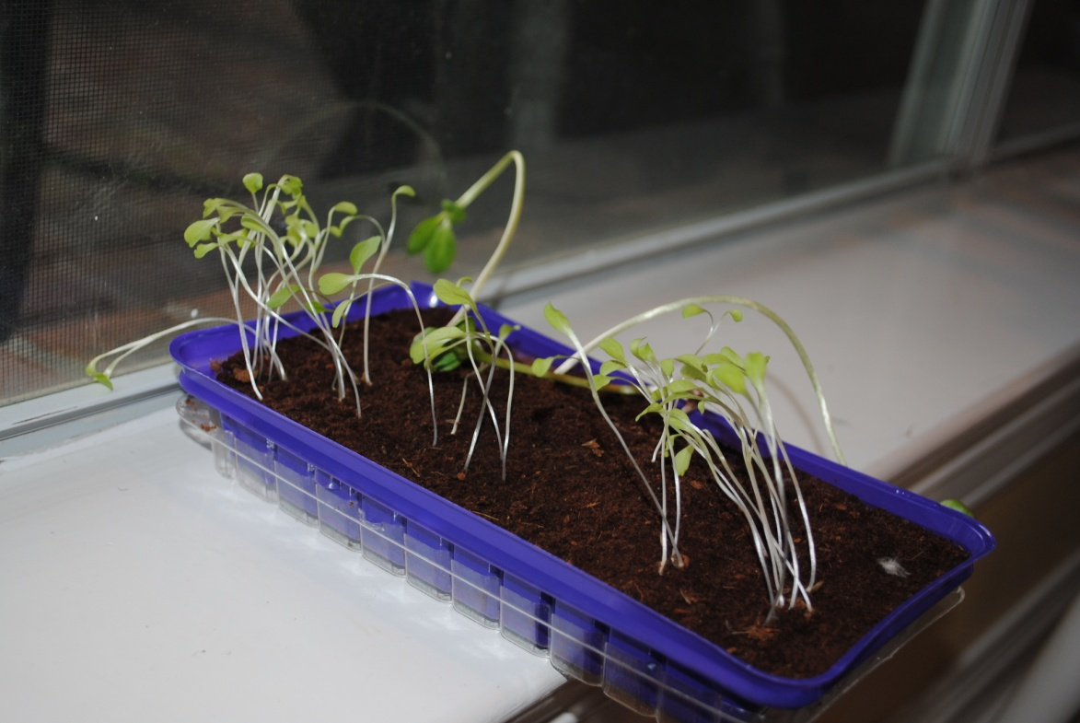

PHOTOTROPISM
(“Photo” – light)
Movement of plants toward light
POSITIVE Phototropism
Stem tip growing TOWARD the light
NEGATIVE Phototropism
Root tip growing AWAY from the light

Slide 7
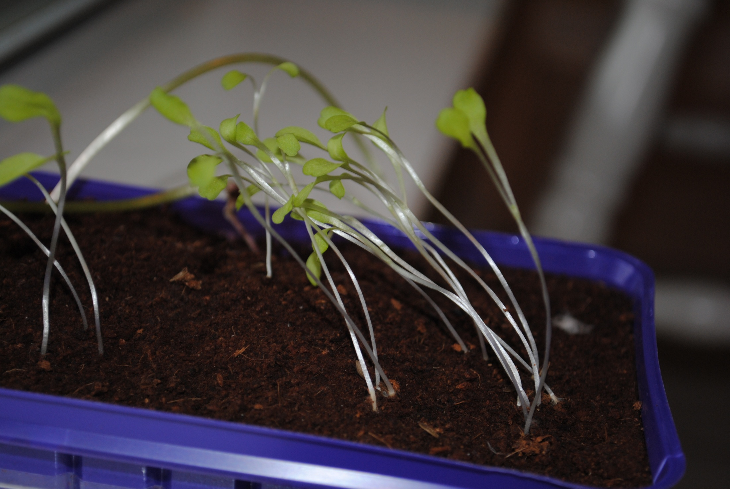

Slide 8
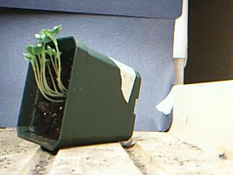
IMPORTANCE OF PHOTOTROPISM
Helps leaves be in the best position possible to receive enough light for photosynthesis

Slide 9
EXAMPLES OF PHOTOTROPISM
http://www.youtube.com/watch?NR=1&v=KQOC_bPrqFs&safety_mode=true&persist_safety_mode=1
http://www.youtube.com/watch?v=Ze8NV7cvW8k&feature=results_main&playnext=1&list=PL5464C68C7644DD4D&safety_mode=true&persist_safety_mode=1

Slide 10
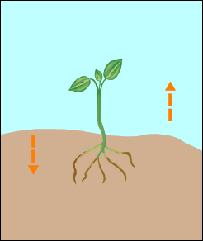
Geotropism
(“Geo” – Earth)
growth of a plant in response to gravity.
Positive Geotropism
It is the growth of a plant toward the center of the earth-down with gravity
Ex. roots growing down
Negative Geotropism
Negative Geotropism
It is the growth of a plant away from the center of the earth-opposite from the pull of gravity
Ex. stems grow up
Positive Geotropism
NEXT

Slide 11
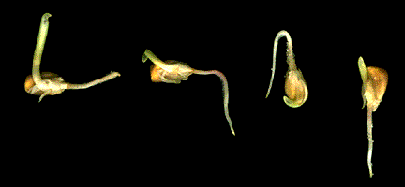
IMPORTANCE OF GEOTROPISM
Pulls roots down to anchor a plant
Roots can get needed water and minerals

Slide 12
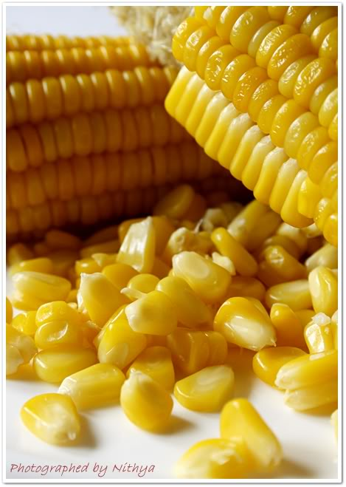
EXAMPLES OF GEOTROPISM
http://www.youtube.com/watch?v=iFCdAgeMGOA&feature=related
http://www.youtube.com/watch?v=mYZXax8V_L0&feature=related&safety_mode=true&persist_safety_mode=1

Slide 13
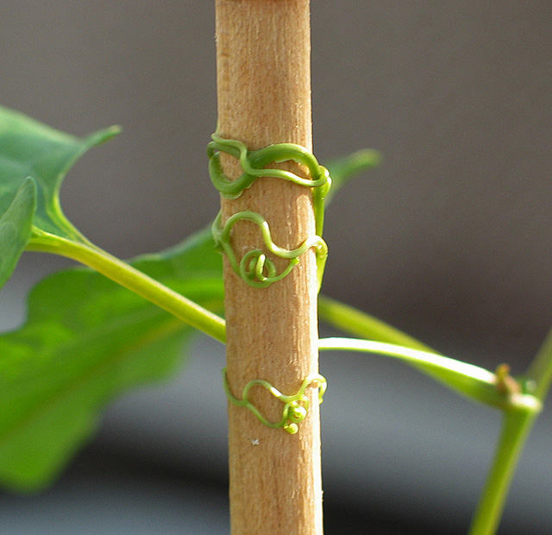
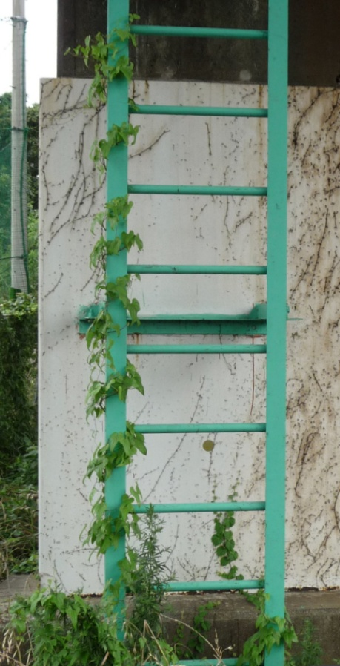
THIGMOTROPISM
(“Thigmo” – “touch”)
growth of a plant in response to touch/contact
Positive Thigmotropism
toward touch
Photo by Christopher Meloche
Negative Thigmotropism
away from touch
(some plants close up when touched)

Slide 14
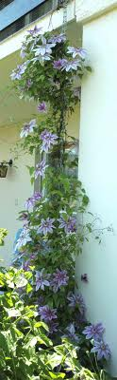
IMPORTANCE OF THIGMOTROPISM
to support leaves as they grow higher to reach the sun to make more food (photosynthesis).

Slide 15
EXAMPLES OF THIGMOTROPISM
http://www.youtube.com/watch?v=8HeedWWe6VA&feature=related&safety_mode=true&persist_safety_mode=1
http://www.youtube.com/watch?v=Zq3UuHlPLQU&feature=related&safety_mode=true&persist_safety_mode=1

Slide 16
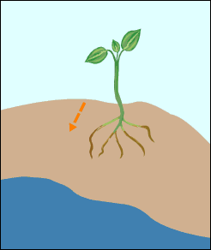
Hydrotropism
(“hydro” – “water”)
Movement by plants toward water
Positive Hydrotropism
toward water
Negative Hydrotropism
Away from water

Slide 17

Importance of Hydrotropism
Roots search for and grow toward water, because it is needed for photosynthesis and to support cell structure

Slide 18
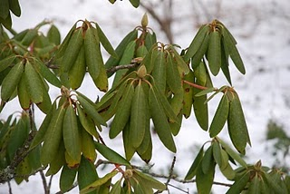
THERMOTROPISM
(“Therm” – “heat”)
to bend toward or away from heat
Positive Thermotropism
toward heat
Negative Thermotropism
Away from heat

Slide 19
Importance of Thermotropism
In colder weather helps prevent water loss through stomata

Slide 20
Example of Thermotropism
http://plantsinmotion.bio.indiana.edu/plantmotion/movements/nastic/nastic.html

Slide 21
Chemotropism
(“Chemo” – chemical)
movement caused by chemical stimuli
Positive Chemotropism
toward high nutrient soil (healthy soil)
Negative Chemotropism
Away from low nutrient soil (unhealthy soil)

Slide 22
IMPORTANCE OF CHEMOTROPISM
Helps control and regulate growth and development of plant

Slide 23
Example of Chemotropism
http://www.yteach.co.za/page.php/resources/view_all?id=auxins_tropisms_nastic_movements_taxes_gametes_fototropism_geotropism_chemotropism_thigmotropism_photonastic_termonastic_seismonastic_movement_t_page_16

Slide 24
