Slide 1
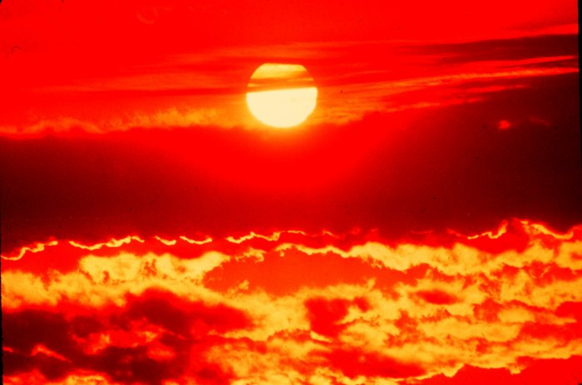
Thermal Energy
&
Heat

Slide 2
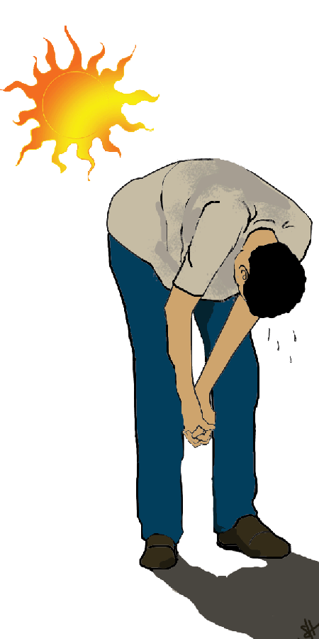
Temperature, Thermal Energy, & Heat

Slide 3
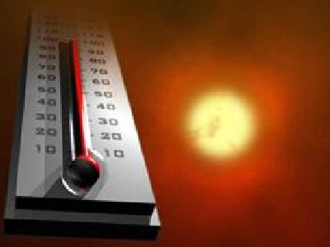
Temperature
When think about temp., scientists think about particles of matter in motion
Remember… ALL matter made up of particles
Particles always moving (even if matter they make up is not moving)
All particles of matter have kinetic energy
Faster particles move, more kinetic energy have
Temperature – measure of the average kinetic energy of the individual particles in matter

Slide 4
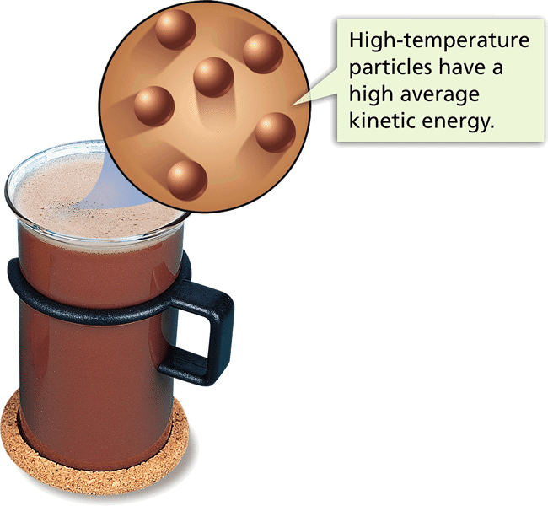
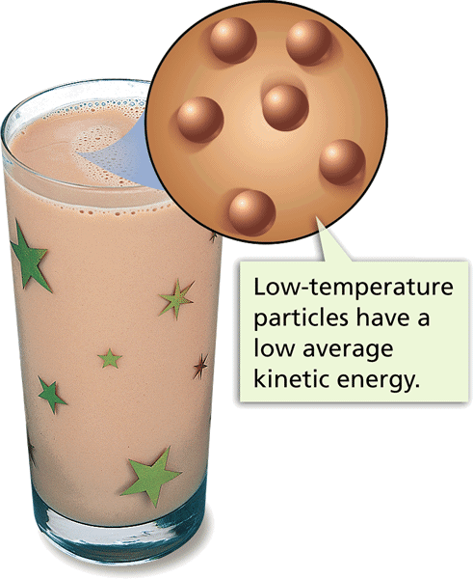

Slide 5
Measuring Temperature
Use thermometer – liquid (mercury or alcohol sealed on inside)
if tube heated, particles of liquid speed up & spread out so particles take up more space
If tube cooled, particles of liquid slow down & move closer taking up less space

Slide 6
Thermal Energy & Heat
Remember…thermal energy is the total potential & kinetic energy of the particles (atoms) in an object
Thermal energy of an object depends on…
# of particles in the object
Temp. of object
Arrangement of particles in object (solid, liquid, gas)

Slide 7
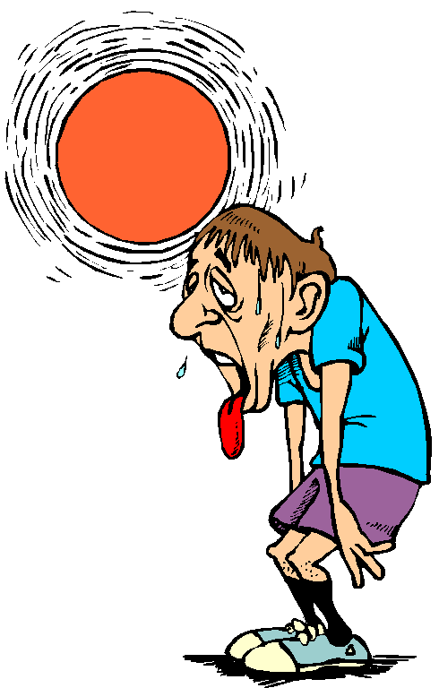
Heat
Defined as thermal energy that is transferred from matter at a higher temp. to matter at a lower temp.
Example – when holding an ice cube in your hand, the ice melts because thermal energy is transferred from your hand to the ice cube

Slide 8
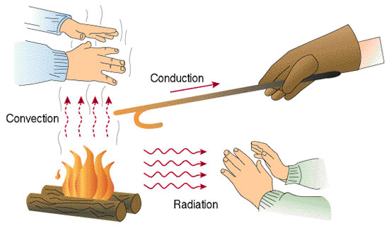
The Transfer of Heat

Slide 9
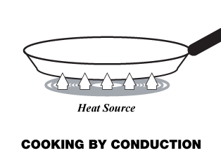
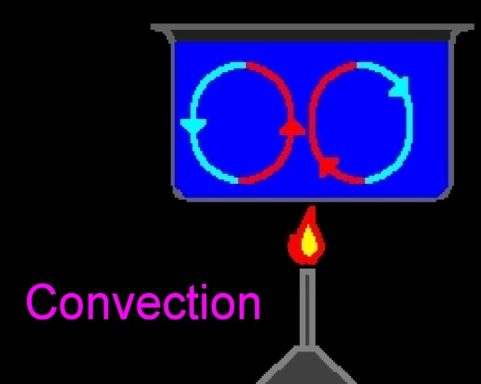
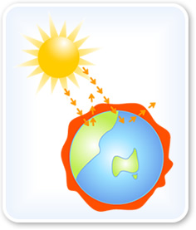
How is Heat Transferred?
3 ways heat can move
1. conduction
2. convection
3. radiation

Slide 10
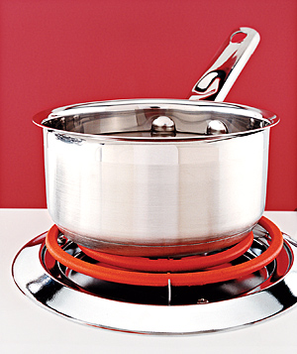
Conduction
Heat transferred from one particle of matter to another w/o the movement of matter
Example – metal spoon in pot of water on electric stove = fast moving particles in electric burner collide w/ slow moving particles in pot. Transfer of heat causes pot’s particles to move faster, then pot’s particles collide w/ particles in spoon. Particles move faster causing spoon to become hotter.

Slide 11
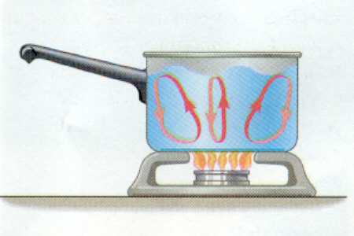
Convection
Heat transferred by the movement of currents within a fluid
Example – water at bottom of pot heated, particles move faster. Particles move farther apart causing heated water to become less dense. Heated water will rise in pot. Surrounding cooler water sinks into it’s place creating a circular motion called a convection current

Slide 12
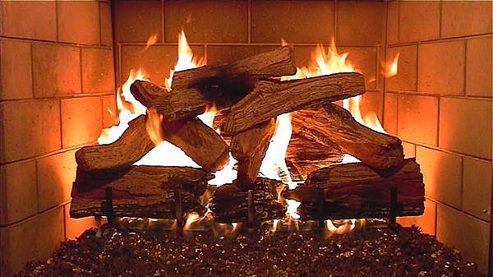
Radiation
The transfer of energy by electromagnetic waves
Example – radiation from a fireplace can be felt across a room

Slide 13
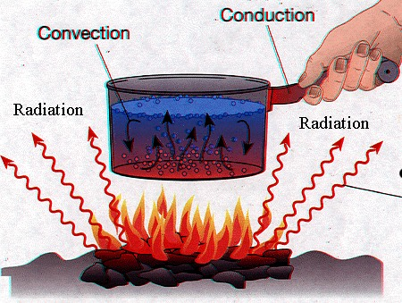

Slide 14
Heat Moves One Way
If two objects have different temps, heat will flow from the warmer object to the colder one.
Heat will flow from one object to the other until the two objects have the same temp.
Thermal equilibrium: The state in which all objects are at the same temperature.

Slide 15
Conductors & Insulators
Materials can be either a conductor or insulator
Conductors – transfer thermal energy well
Ex – silver, stainless steal, tile floor
Insulators – do not transfer thermal energy well
Ex – wood, wool, straw, paper, clothes, blankets

Slide 16
Thermal Expansion
Question…
Have you ever loosened a tight jar lid by holding it under a stream of hot water? Why does this work?
Because the metal lid expands a little
As the thermal energy of matter increase, its particles spread out and the substance expands

Slide 17
The expanding of matter when it is heated is called thermal expansion
When matter cooled, thermal energy released
Particles slow down and move closer together
As cools, matter contracts (decreases in volume
The ball fits through the loop
when cold, does not when hot.

