Slide 1
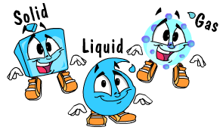
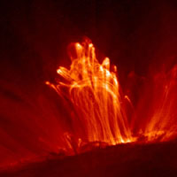
Solids, Liquids,
Gases & Plasmas

Slide 2
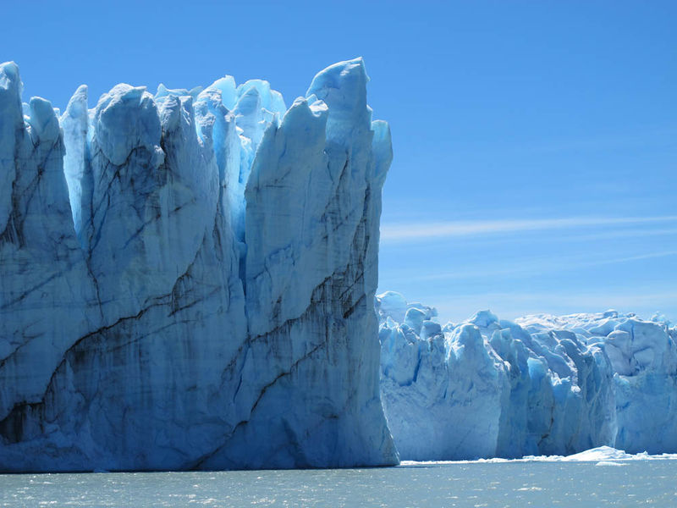
States of Matter
different forms in which matter can exist.
Example – Water
Solid (Iceberg)
Liquid (Ocean Water)
Gas (Water Vapor in air)
In all 3 states, water is still water
Has the same chemical makeup & properties
State of matter is a PHYSICAL CHANGE

Slide 3
States of Matter
http://www.youtube.com/watch?v=s-KvoVzukHo&feature=related
http://www.youtube.com/watch?v=NO9OGeHgtBY&feature=related

Slide 4
States of Matter
Gases
Shape of Container
Volume of Container
Liquids
Shape of Container
Free Surface
Fixed Volume
Solids
Holds Shape
Fixed Volume

Slide 5
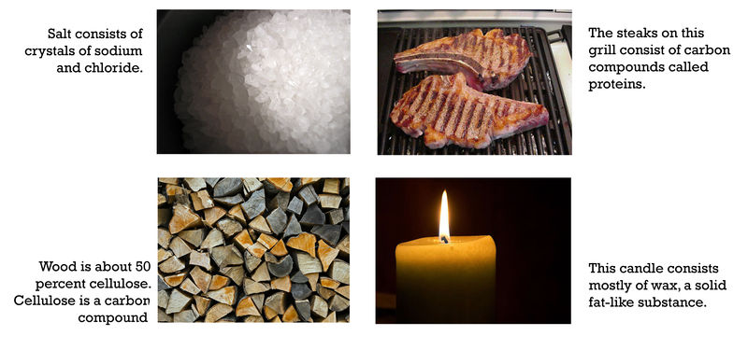
Solids
matter that has a fixed volume and a fixed shape
The volume and shape of a solid can be changed, but only with outside help

Slide 6
Liquids
matter that has a fixed volume but not a fixed shape
takes the shape of its container
Two properties of liquids are surface tension and viscosity
Surface tension is a force that pulls particles at the exposed surface of a liquid toward other liquid particles.
Viscosity is a liquid’s resistance to flowing. Thicker liquids are more viscous than thinner liquids.
http://www.youtube.com/watch?v=ciqNNRlS2yA
http://www.youtube.com/watch?v=3KU_skfdZVQ

Slide 7
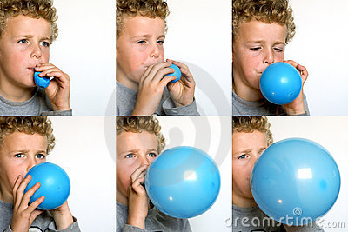
Gases
matter that has neither a fixed volume nor a fixed shape
takes both the volume and the shape of its container

Slide 8
Plasma
state of matter that resembles a gas but has certain properties that a gas does not have
most of the universe consists of plasma
lacks a fixed volume and shape
can conduct electricity and respond to magnetism
it glows with light
http://www.ck12.org/flx/render/embeddedobject/5073

Slide 9
Energy
defined as the ability to cause changes in matter
can change energy from one form to another, BUT it CANNOT be created nor destroyed
Known as the Law of Conservation of Energy
The energy of moving matter is called kinetic energy

Slide 10
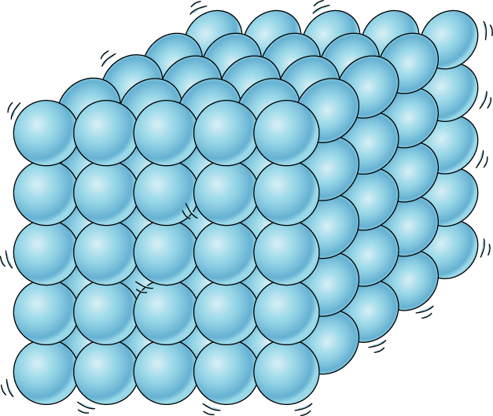
Energy & States of Matter
Particles of matter of the same substance, such as the same element, are attracted to one another
In solids, particles don’t have enough kinetic energy to overcome the force of attraction between them. The particles are packed closely together and cannot move around. All they can do is vibrate. This explains why solids have a fixed volume and shape.

Slide 11
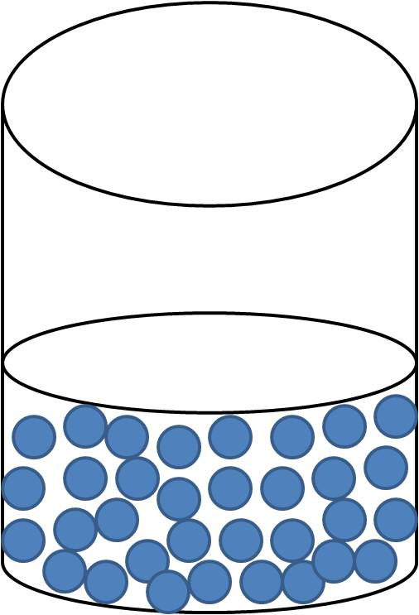
Energy & States of Matter
In liquids, particles have enough kinetic energy to partly overcome the force of attraction between them.
Can slide past one another but not pull completely apart. This explains why liquids can change shape but have a fixed volume.

Slide 12
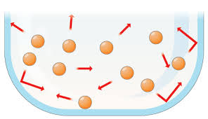
Energy & States of Matter
In gases, particles have a lot of kinetic energy. They can completely overcome the force of attraction between them and move apart.
This explains why gases have neither a fixed volume nor a fixed shape.

Slide 13
Viscosity & Surface Tension
Viscosity
http://www.youtube.com/watch?v=3KU_skfdZVQ
Surface Tension
http://www.youtube.com/watch?v=ciqNNRlS2yA

