Slide 1
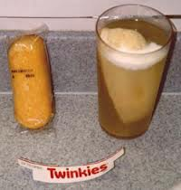
Solubility

Slide 2
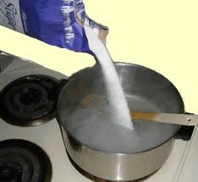
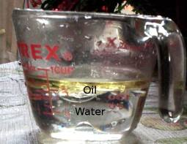
Solubility is a physical property, that measures the ability of a substance to dissolve.
It can be used to help identify a substance.
Insoluble: When one substance can not dissolve into another substance.
For example oil is insoluble in water.

Slide 3
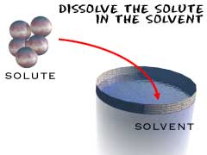
Solution: A mixture that forms when one substance dissolves another.
A solution has the same properties throughout.
Contains a solvent and at least one solute

Slide 4
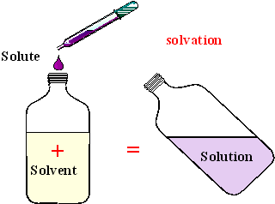
Solvent: A substance that dissolves another substance
Typically a liquid
present in the larger amount in a solution.
Example : Water dissolves salt.
Solute: The part of a solution present in the smaller amount
Can be a solid, liquid or gas.
the solute is dissolved by the solvent.
Example: Salt is dissolved by water.

Slide 5
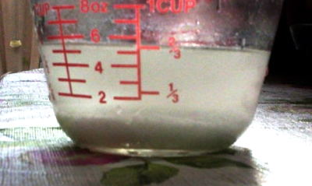
Saturated Solution: A mixture that contains as much dissolved solute as possible at a given temperature.
When a solution can have solute added and dissolved the solution is unsaturated.

