Slide 1
Pop Pop Learn A Lot
Answer the 4 Pre-Demo Discussion questions in complete sentences
What is heat?
How would you explain or describe heat transfer?
Can you name any methods of heat transfer? List them.
What makes popcorn pop?

Slide 2
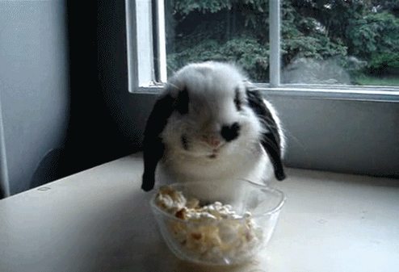
Demonstration Time
Get ready to think and write like a scientist!
As you watch the demonstration, write your QUALITATIVE observations in the table. REMEMBER – be detailed in your writing
Review – What are qualitative observations?

Slide 3
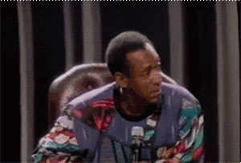
Analysis Time
With someone sitting next to you, discuss and answer the 3 analysis questions.
Remember, you are in “scientist” mode, so talk science.
Use your vocabulary & be detailed
Explain your reasoning (why do you think what you do)
Use COMPLETE sentences
Once you are done with the 3 analysis questions, you need to find 2 other students to join with (choose wisely) to complete the Venn Diagram portion.
You will be provided with a sheet of construction paper to create your final product

