Slide 1
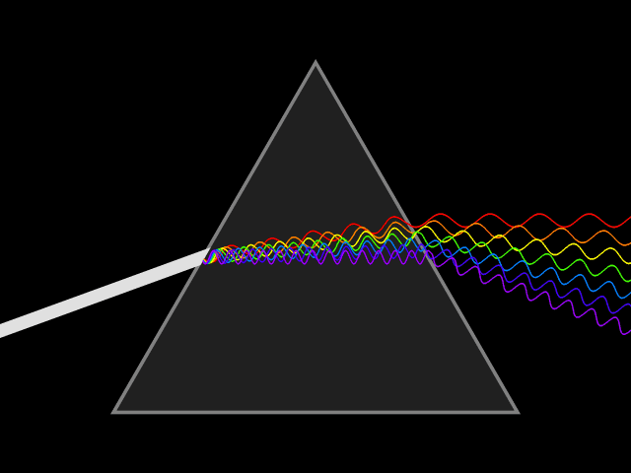
Light & Color

Slide 2
When Light Strikes an Object
When light strikes an object, the light can be
Absorbed (take it in)
Reflected (bounce off/scatter)
Transmitted (carrying it/moving it)
Materials can be classified as
Transparent
Opaque
Translucent
This is based on what happens to light that strikes the material

Slide 3
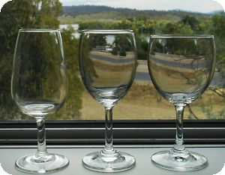
Transparent Materials
Transmits most of the light that strikes it
Light passes right through without being scattered
See clearly what’s on other side
Examples = water, clear glass, air

Slide 4
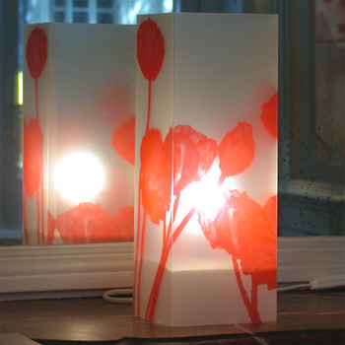
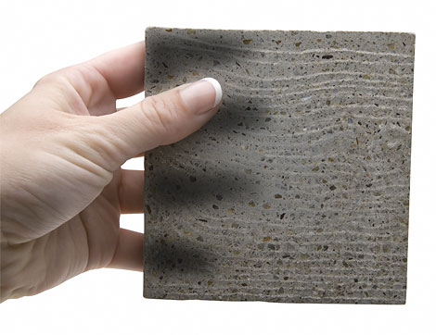
Translucent Materials
Scatters light as it passes through
Usually can see something behind object, but is blurred
Example = wax paper, frosted glass

Slide 5
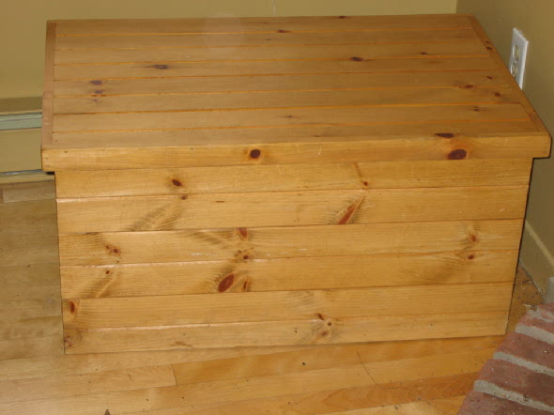
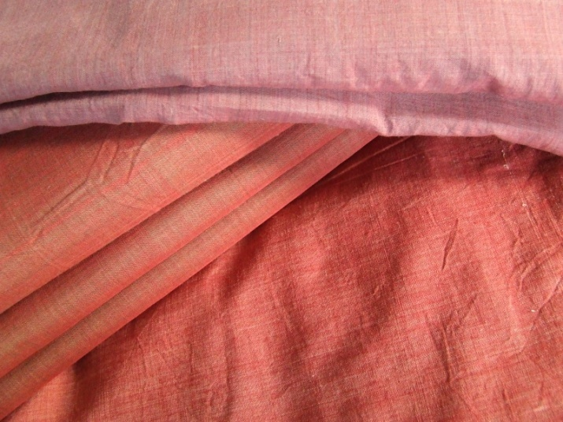
Opaque Materials
Reflects or absorbs ALL of the light that strikes it
Cannot see through because light cannot pass through them
Example = metal, wood, tightly woven fabric

Slide 6
The Color of Objects
If you know how light interacts w/ objects can explain why objects have different colors
Color of objects depends on
Material object made of
Color of light striking object

Slide 7
Color of Opaque Objects
Depends on wavelengths of light that object reflects
Every opaque object absorbs some wavelengths of light and reflects others
Color of an opaque object is the color of the light it REFLECTS

Slide 8
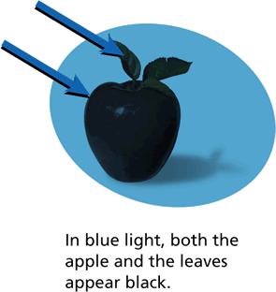
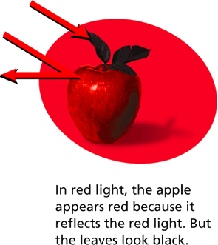
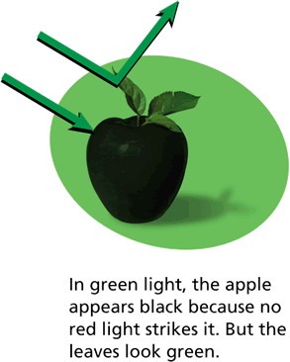

Slide 9
Color of Transparent & Translucent Objects
Allow only certain colors of light to pass through them
Reflect or absorb other colors
The color of the transparent or translucent object is the color of the light it transmits

Slide 10
Examples -
White light shines through transparent blue glass
glass appears blue because it transmits blue light
Glass or plastic that only allows red light to pass through will be red

Slide 11
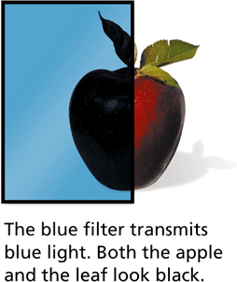
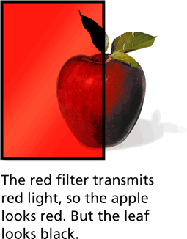
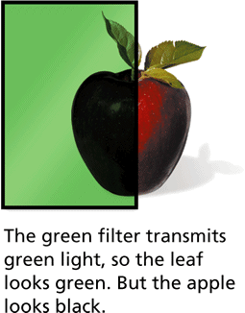

Slide 12
Combining Colors
Primary Colors = three colors that can combine to make any other color
Secondary Colors = two primary colors combined in equal amounts

Slide 13
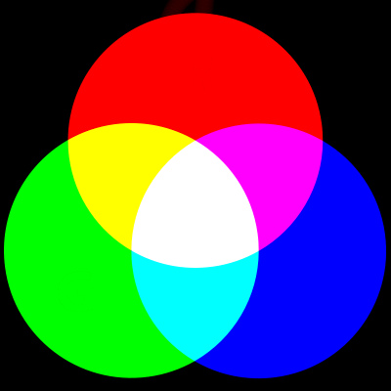
Mixing Colors of Light
Primary colors = RED, GREEN, BLUE
When combined in equal amounts, the 3 primary colors of light produce white light
If mixed in different amounts can produce other colors
Example = RED + GREEN = YELLOW
Secondary colors of light =
Yellow
Magenta
Cyan

Slide 14
Mixing Pigments
Pigments = colored substances that are used to color other materials
Absorb some color, but reflect others
Color seen is result of colors that particular pigment reflects

Slide 15
Mixing pigments is DIFFERENT from mixing colors of light
As pigments are added together, fewer colors of light are REFLECTED and more are ABSORBED
the more pigments combined, the darker the mixture looks

Slide 16
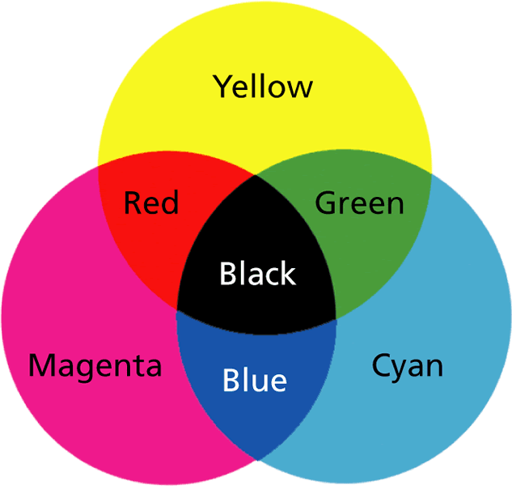
Cyan, Magenta, Yellow primary colors of pigments
Combine in equal amounts to produce black
Can combine primary pigments in different amounts to get secondary colors of RED, GREEN, BLUE
Do you notice the difference in the color wheel?

Slide 17
LIGHT
PIGMENT

Slide 18
Light & Color

