Slide 1
Discovery Education Assignment Review

Slide 2
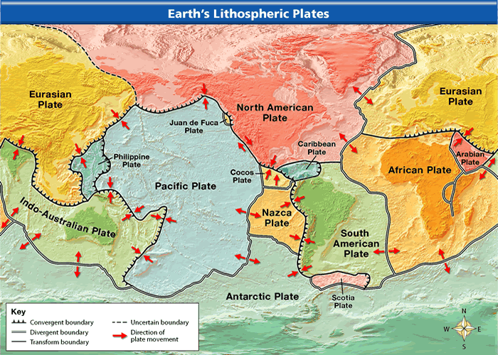
The Lithosphere divided
Into plates
Also called crustal plates; lithospheric plates, tectonic plates

Slide 3
Lithosphere vs. Asthenosphere
Lithosphere
Asthenosphere
Includes the crust and upper , upper mantle
Thinnest layer
Below the lithosphere
In upper mantle
Higher temperature
Solid; moves like plastic/silly putty
NOT a liquid
Because of the movement of the asthenosphere (its ability to bend), the lithosphere is able to move/slide around on top

Slide 4
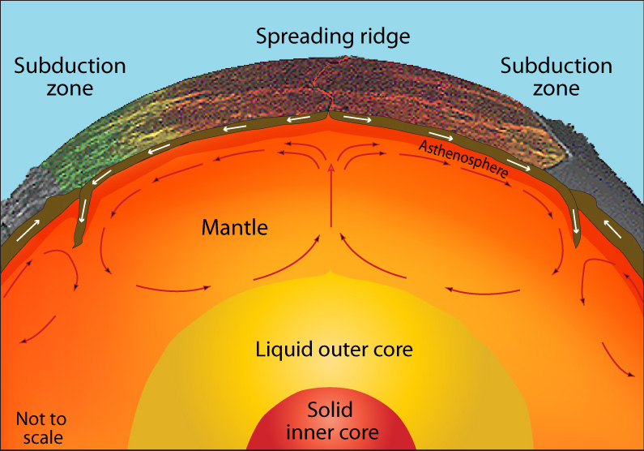
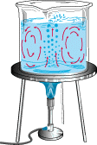
What allows the lithosphere to move?
The convection currents within the mantle
Remember convection is a form of heat transfer
Convection is like a boiling pot. Heated water rises to the surface, spreads and begins to cool, and then sinks back to the bottom of the pot where it is reheated and rises again.

Slide 5
Where do most earthquakes & volcanoes occur?
Along the colliding edges of most plates
Latest Earthquakes & Volcanoes

Slide 6
Plate Tectonics
This explains how the forces within the earth move the plates around
The theory states: pieces of Earth’s lithosphere are in slow, constant motion, moved by currents in the mantle

Slide 7
As the mantle circulates…
Crust slides around, pulls apart, pushes together, and reshapes land
This is where we get the three main types of plate boundaries!
The three main types of boundaries are…
DIVERGENT
CONVERGENT
TRANSFORM
Most earthquake and volcanic activity happens here at the boundaries

Slide 8
DIVERGENT BOUNDARIES
“Move Away” from one another (think of the word diverge)
Rifts form (largest is Mid-Atlantic Ridge)
Seafloor spreading occurs; New curst forms
Earthquakes &
Volcanoes can occur

Slide 9
CONVERGENT BOUNDARIES
“Come together,” “Crash into,” “collide” (think of the word ‘converge’)
Mountains and/or Volcanoes can form
Subduction zones can be created (density matters here)
Earthquakes can occur
Types of Convergent Boundaries
Oceanic vs. Continental
Continental vs. Continental
Oceanic vs. Oceanic

Slide 10
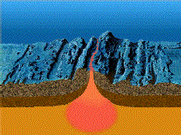
Where is new crust formed?
At mid-ocean ridges
Remember – this is a divergent boundary
When new curst is created, it causes the ocean floor to “spread”
Sea Floor Spreading

Slide 11
How is the crust destroyed?
Happens at convergent boundaries
The “diving” plate is consumed back into mantle at a subduction zone
This process is called subduction

