Slide 1
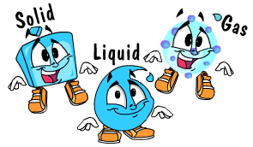
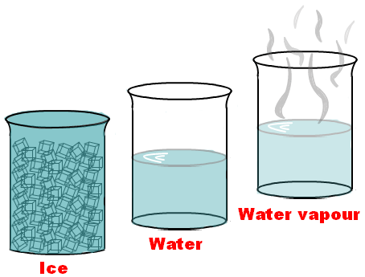
Changes of State

Slide 2
Matter is always changing state
How does matter change from one state to another?
changes in energy are involved

Slide 3
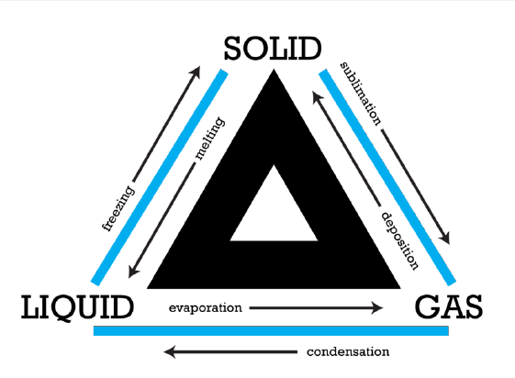
What are Changes of State?
physical changes in matter
reversible changes that do not involve changes in matter’s chemical makeup or chemical properties

Slide 4
Energy, Temperature, & Changes of State
Energy is always involved in changes of state. Matter either loses or absorbs energy when it changes from one state to another
For example, when matter changes from a liquid to a solid, it loses energy
The opposite happens when matter changes from a solid to a liquid
For a solid to change to a liquid, matter must absorb energy from its surroundings
http://www.youtube.com/watch?v=ndw9XYA4iF0

Slide 5
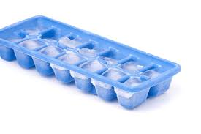
Changes Between Liquids & Solids
How would you make ice cubes?
The warmer water in the tray loses heat to the colder air in the freezer
The water cools until its particles no longer have enough energy to slide past each other
Instead, they remain in fixed positions, locked in place by the forces of attraction between them

Slide 6
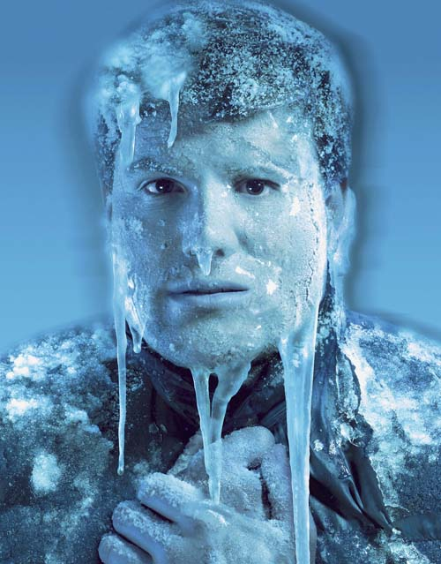
Freezing
The process in which a liquid changes to a solid
The temperature at which a liquid changes to a solid is its freezing point
Example - The freezing point of water is 0°C (32°F)

Slide 7
Changes Between Liquids & Solids
What would happen if you took the ice trays out of the freezer?
If you took ice cubes out of a freezer and left them in a warm room, the ice would absorb energy from the warmer air around it
The energy would allow the particles of frozen water to overcome some of the forces of attraction holding them together
They would be able to slip out of the fixed positions they held as ice
In this way, the solid ice would turn to liquid water.

Slide 8
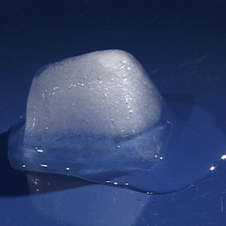
Melting
The process in which a solid changes to a liquid is called melting
The melting point is the temperature at which a solid changes to a liquid
For a given type of matter, the melting point is the same as the freezing point
So the melting point & freezing point of water is the SAME
http://en.wikipedia.org/wiki/File:Melting_icecubes.gif

Slide 9
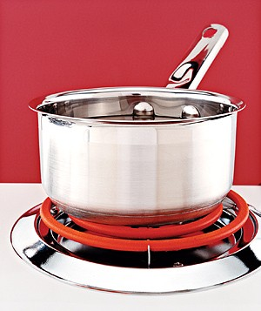
Changes Between Liquids & Gases
If you fill a pot with cool tap water and place the pot on a hot stovetop, the water heats up. Heat energy travels from the stovetop to the pot, and the water absorbs the energy from the pot. What happens to the water next?
If water gets hot enough, it starts to boil
Bubbles of water vapor form in boiling water
This happens as particles of liquid water gain enough energy to completely overcome the force of attraction between them and change to the gaseous state. The bubbles rise through the water and escape from the pot as steam

Slide 10
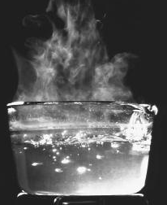
The process in which a liquid boils and changes to a gas is called vaporization
The temperature at which a liquid boils is its boiling point
Example - The boiling point of water is 100°C (212°F)
Vaporization

Slide 11
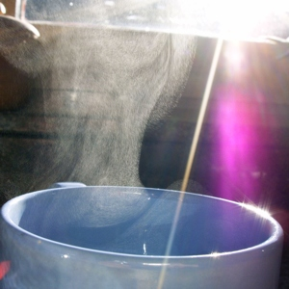
Evaporation (still vaporization)
A liquid can also change to a gas without boiling. This process is called evaporation
occurs when particles at the exposed surface of a liquid absorb just enough energy to pull away from the liquid and escape into the air
This happens faster at warmer temperatures

Slide 12
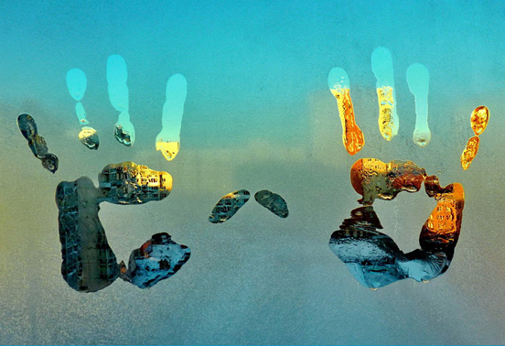
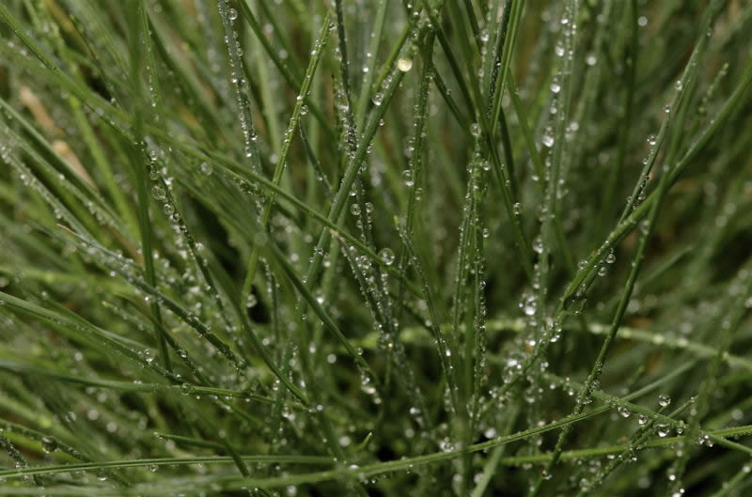
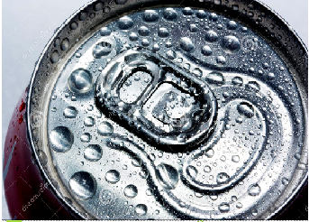
What is happening in these photos?

Slide 13
Condensation
The water vapor in the air comes into contact with the cooler surfaces of the grass, mirror and soda can
When it does, it loses energy
The cooler particles no longer have enough energy to overcome the forces of attraction between them
They come together and form droplets of liquid water
The process in which a gas changes to a liquid is called condensation

Slide 14
Changes Between Solids & Gases
Sometimes solids change directly to gases and skip the liquid state
Sometimes gases change directly to solids

Slide 15
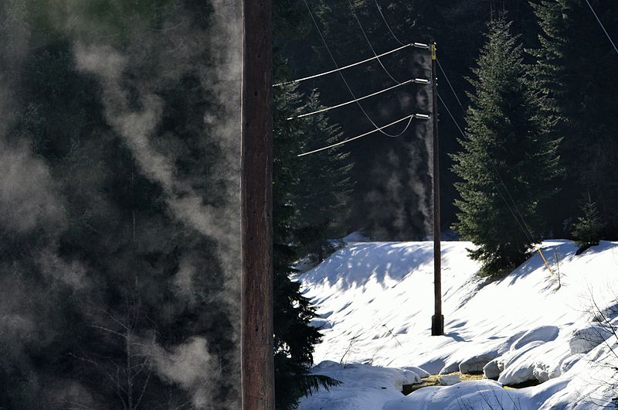
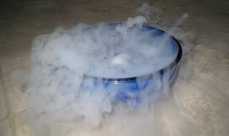
Sublimation
The process in which a solid changes directly to a gas is called sublimation. It occurs when the particles of a solid absorb enough energy to completely overcome the force of attraction between them.
Example - Dry ice (solid carbon dioxide)

Slide 16
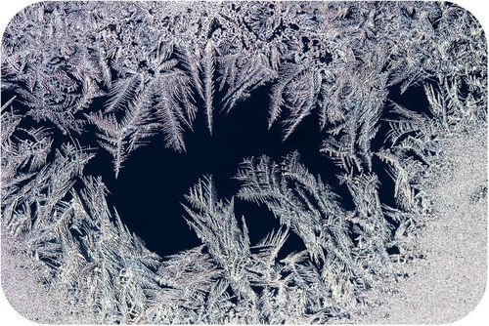
Deposition
The opposite of sublimation is deposition; the process in which a gas changes directly to a solid without going through the liquid state
It occurs when gas particles become very cold
For example, when water vapor in the air contacts a very cold windowpane, the water vapor may change to tiny ice crystals on the glass. The ice crystals are called frost

