Slide 1
Thursday December 12, 2013
Bellwork: Open your notebook to page 31R (32R for 4th pd). Copy down the following information….
List the following in order from smallest to largest…
Solar system, universe, planet, galaxy
planet
Solar system
Galaxy
Universe

Slide 2
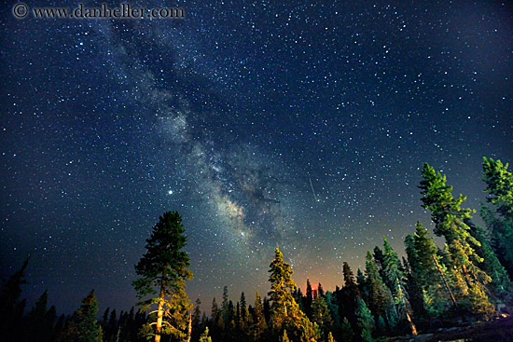
Have you ever looked up on a clear night and seen a hazy band stretched across the sky? You are looking into the galaxy we live in. What is the name of our galaxy?
We live in the …
Galaxy

Slide 3
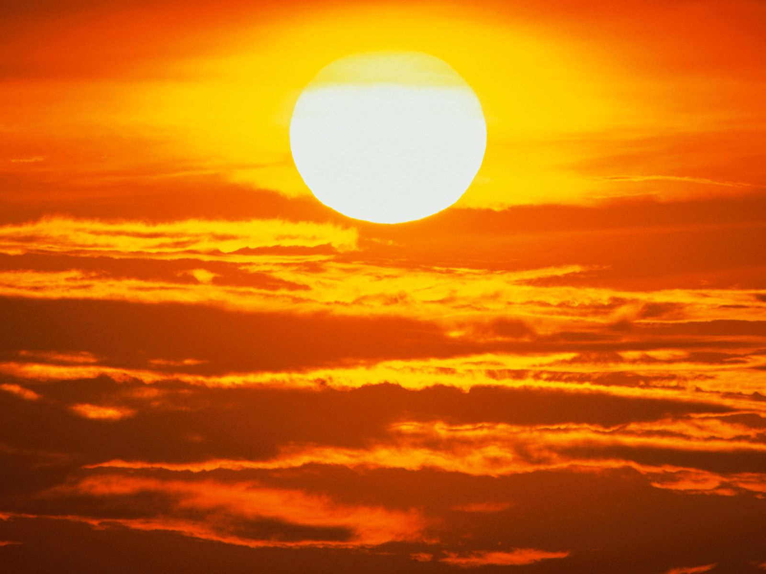
I am the most object in our solar system.
MASSIVE
What am I?
THE
SUN

Slide 4
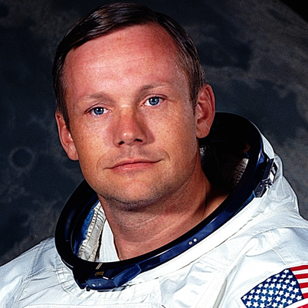
“It’s one small step for man, one giant leap for mankind”
I said this as I took the first EVER steps on the moon. Who am I?
Neil
Armstrong

Slide 5
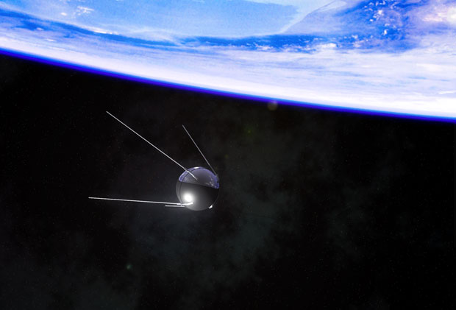
Russia successfully launched the first artificial satellite in October 1957
The name of this satellite is…
Sputnik 1

Slide 6
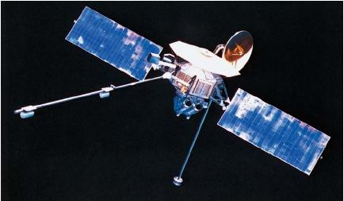
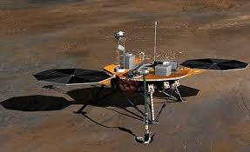
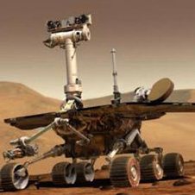
What is a space probe?
A space probe is a spacecraft that travels through space to collect science information. Probes do not have astronauts. Probes send data back to Earth for scientists to study.

