Slide 1
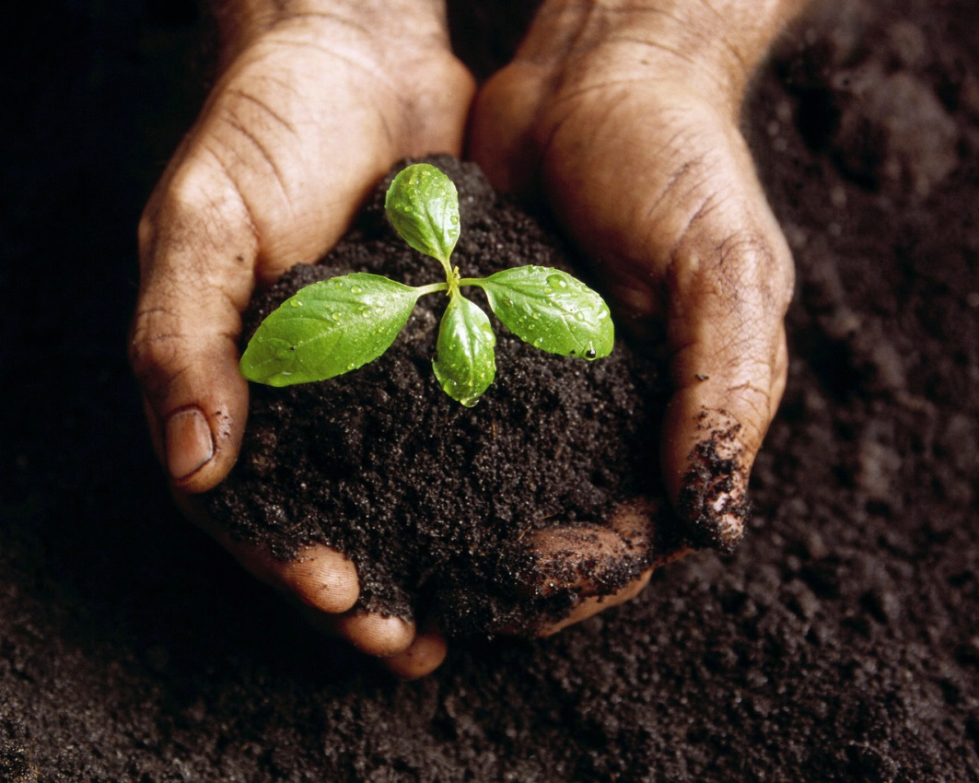
Soil Formation
How Soil Forms

Slide 2
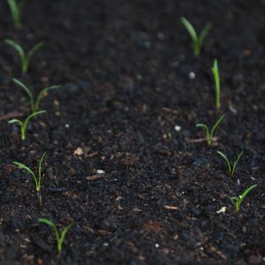
What is Soil?
The loose, weathered material on Earth’s surface where plants can grow

Slide 3
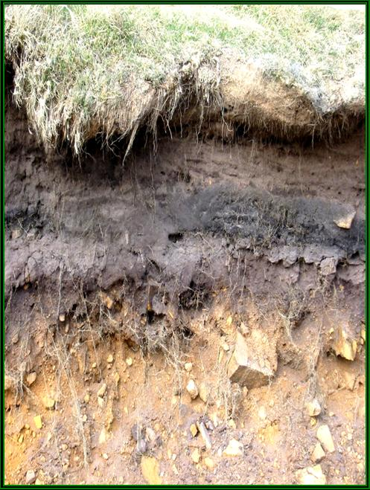
Soil Composition
One main ingredient of soil is bedrock
  Solid layer of rock beneath soil
  When exposed to surface of Earth weathers into smaller pieces that are basic materials of soil
Other materials of soil (5)
  Rock particles (sand, silt, clay)
  Minerals

Slide 4
Soil Composition cont.
  3. Decayed organic material
    Called humus – dark colored substance that forms as plants and animal remains decay
      Helps create spaces in soil for air & water
      Contains nutrients that help plants grow
  4. Water
  5. air

Slide 5
What is in soil?

Slide 6
Soil Formation - How does it happen?
Soil forms as rock is broken down by weathering & mixes with other materials on the surface
Soil is constantly being formed whenever bedrock is exposed

Slide 7
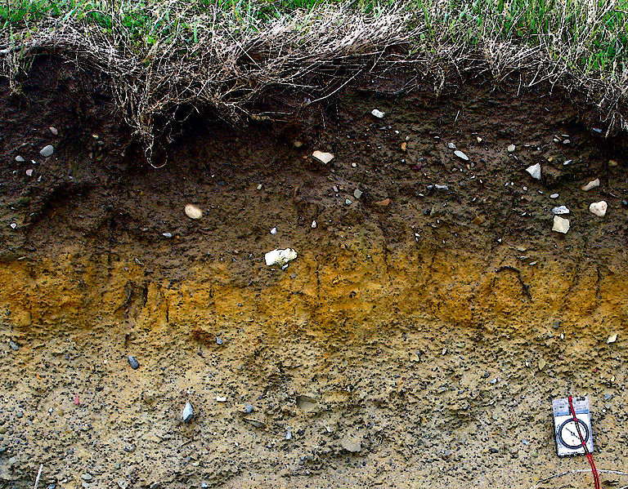
Soil develops layers called horizons
  Soil horizon – layer of soil that differs in color and texture from the layers above or below it

Slide 8
Horizon
Horizon is a side profile of the layers of soil
Soil is usually divided into 3 main layers, but will also include the layers above and below for a total of 5 layers.

Slide 9
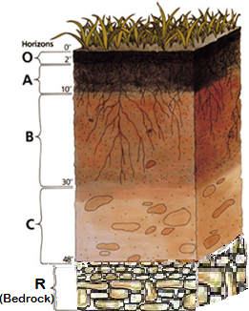
SOIL HORIZON DIAGRAM
LITTER
TOPSOIL
SUBSOIL
PARENT MATERIAL
BEDROCK

Slide 10
O Horizon: Litter
Not really a layer of soil
It’s on top of the first layer of soil
Contains grass, plants, and animals

Slide 11
A Horizon: Topsoil
1st layer of soil
Darkest layer of soil (dark brown or black)
Contains humus, plant roots, small animals, water, and nutrients for plant growth
The darker the soil, the more nutrients it contains

Slide 12
B Horizon: Subsoil
2nd layer of soil
Lighter in color (reddish brown)
Fewer nutrients and water
Limited plant growth

Slide 13
C Horizon: Parent Material
3rd layer of soil
Lightest in color (gray)
No nutrients, animals, or plant growth
Contains weathered rock and sediment

Slide 14
R Horizon: Bedrock
Below the last layer of soil
Solid Rock
Has not been weathered or broken down yet
No soil in this layer

Slide 15
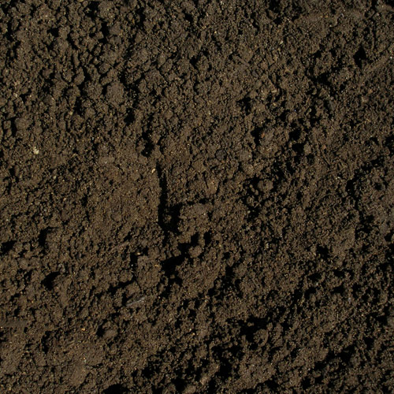
Soil Conservation

Slide 16
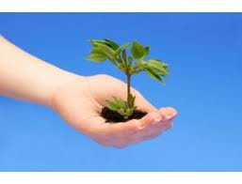
Stewardship
Responsibility for planning and management of resources

Slide 17
Does soil have any value?
Soil is one of Earth’s most valuable natural resources
  everything that lives on land depends directly or indirectly on soil
    Plants depend on soil to live and grow (direct)
    Humans & animals depend on plants (indirect)

Slide 18
Soil Damage
Value of soil reduced when topsoil lost due to erosion
  When soil exposed, water & wind can erode it
  Plant cover can protect soil from erosion

Slide 19
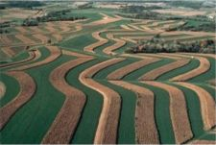
Soil Conservation
The management of soil to prevent its destruction
Three ways to conserve
  Contour Plowing – plow fields along curves or slope.
    Slows down runoff or excess water and prevents it from washing soil away

Slide 20
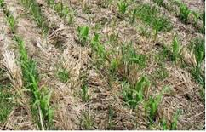
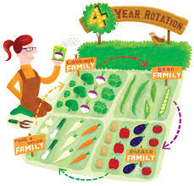
  Conservation plowing – disturb soil and its plant cover as little as possible
    Dead weeds/plants left from previous year so nutrients returned to soil & retains moisture
3. Crop Rotation – plants different crops in a field each year
    Different types of plants absorb different amounts of nutrients

Slide 21
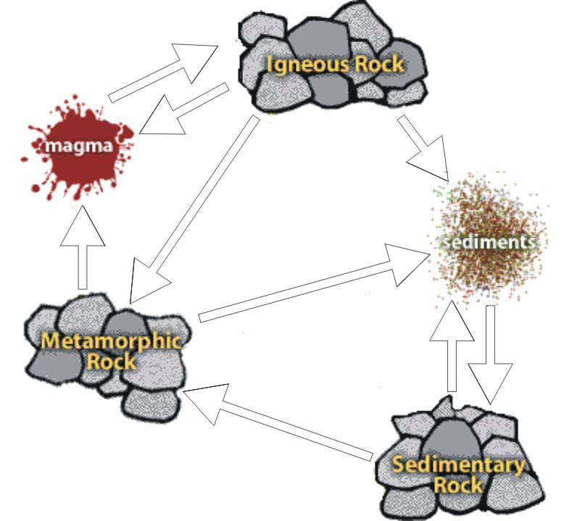
The Rock Cycle: color your arrows- make sure each process is the same color
cooling
melting
Weathering & Erosion
Heat & pressure
melting
Weathering & Erosion
Compaction & Cementation
Weathering & Erosion
Heat & pressure

