Slide 1
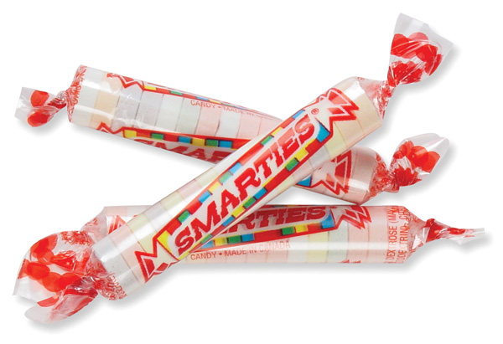
Smarties & Solubility
(write this title on page 19L)
Explain the term solubility. Take your best guess!
If you place a smartie on your tongue w/o biting it, how long do you think it will take to dissolve?
Write your hypothesis on page 19L

Slide 2
On my “go” take your smartie and place it on your tongue.
Move the whole smartie around in your mouth w/ your tongue
DO NOT BITE IT! Just let the smartie sit on your tongue
Write down how long it took for your smartie to dissolve.
Whole Smartie = ________

Slide 3
Smarties…Take Two
If you place a smartie on your tongue and bite it in half, how long do you think it will take to dissolve?
Write your hypothesis #2 on page 19L
On my go, take your second smartie and place it on your tongue.
Bite the smartie in half, then move it around in your mouth w/ your tongue

Slide 4
Write down how long it took for your smartie to dissolve.
Bitten Smartie = ________
Was there a difference in results? Why or why not? Explain on page 19L

