Slide 1
Rotation, Revolution, & Seasons

Slide 2
Why does Earth have day & night?
Because the Earth rotates
Rotation is the spin of an object about its axis.
The Earth rotates once a day (once every 24 hours).

Slide 3
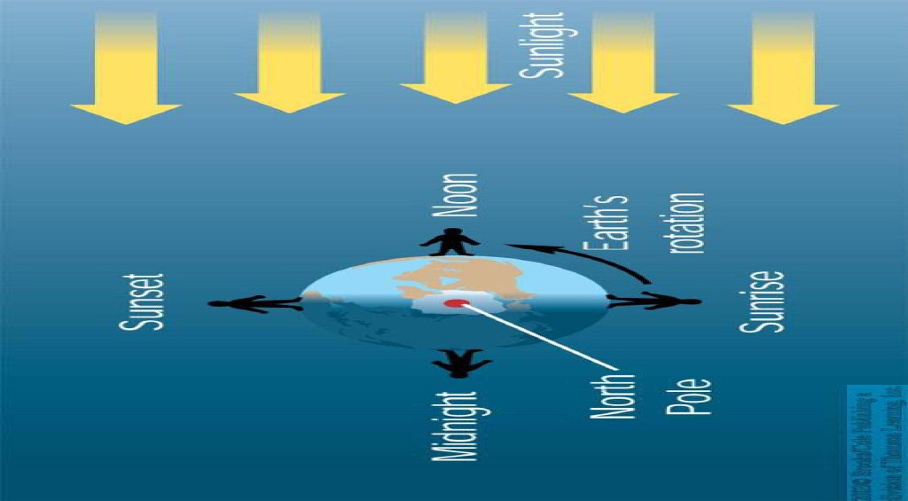

Slide 4
Why does Earth have seasons?
The yearly cycle of the Earth’s seasons is caused by the tilt of Earth’s axis as it revolves around the sun
Revolution is the orbit of one object around another.
Earth's Orbit and Daylight http://www.mathsisfun.com/earth-orbit.html

Slide 5
Earth’s Seasons in the N. Hemisphere
Day in N. Hemisphere | Approximate Date each year | Length of Daytime | Hemisphere that is tilted toward the sun
Summer Solstice | June 21 | Longest Day | Northern
Autumnal Equinox | September 22 | Daytime & Night time both 12 hours | Neither
Winter Solstice | December 21 | Shortest Day | Southern
Vernal (Spring) Equinox | March 21 | Daytime & Night time both 12 hours | Neither

Slide 6
Phases, Eclipses, Tides

Slide 7
How long does it take the moon…
To rotate once on its axis?
It takes 27.3 days
To revolve once around the Earth?
It takes 27.3 days
A day & a year on the moon are the same length
Synchronous Rotation of the Moon – YouTube http://www.youtube.com/watch?v=OZIB_leg75Q

Slide 8
Phases of the Moon
Phases of the Moon – YouTube http://www.youtube.com/watch?v=AQRNzepe4wI

Slide 9
Waxing vs. Waning
“Waxing” refers to the increase of light
“Waning” refers to the decrease of light

Slide 10
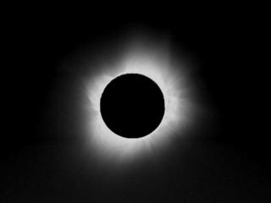
Solar Eclipse
occurs when the Moon passes between the Sun and the Earth, and the Moon fully or partially blocks the Sun
(show file - ess05_vid_totaleclipse_450)

Slide 11
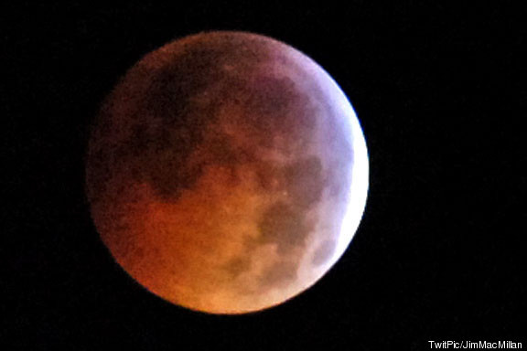
Lunar Eclipse
A lunar eclipse occurs when the Moon passes behind the Earth so that the Earth blocks the Sun's rays from striking the Moon.
This can occur only when the Sun, Earth, and Moon are aligned exactly, or very closely so, with the Earth in the middle.
Hence, a lunar eclipse can only occur the night of a full moon.
NASA - NASA Releases New Lunar Eclipse Video
http://www.nasa.gov/mission_pages/LRO/news/eclipse-video.html

Slide 12
What is the main cause of tides on Earth?
Explain why there are two high tides and two low tides.
BrainPOP | Science | Learn about Tides

