Slide 1
Refraction of Light
When light rays enter a medium at an angle, the change in speed causes the rays to bend, or change direction
Some mediums cause light to bend more than others
A material’s index of refraction is a measure of how much a ray of light bends when it enters that material
Higher the index the more it bends

Slide 2
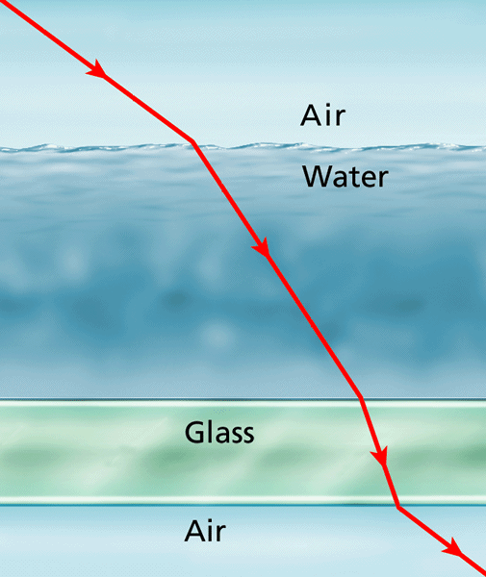
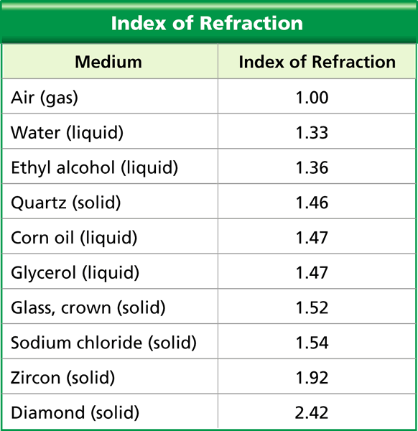

Slide 4
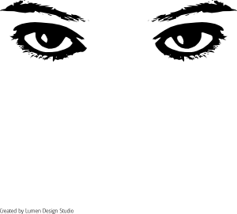
Seeing Light

Slide 5
The Human Eye
Allows you to sense light
See light when a process occurs that involves both your eyes and brain

Slide 6
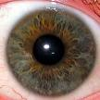
Light Enters the Eye
Enters eye through cornea
Clear covering over the eye; Protects the eye
Acts as a lens to help focus light rays
After passing through cornea, light enters the pupil
Opening where light enters inside of the eye
Appears larger to let more light in
Appears smaller to let less light in
Iris is a ring of muscle that contracts & expands to change size of pupil
controls how much light enters the eye
Gives eye its color

Slide 7
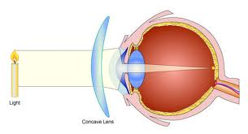
An Image Forms
After entering pupil, light passes through lens
We have a convex lens that refracts light to form image on lining of your eyeball
Ciliary muscles hold lens in place behind pupil
When focus on distant object, muscles relax and lens becomes longer & thinner
When focus on nearby object, muscles contract and lens becomes shorter & fatter

Slide 8
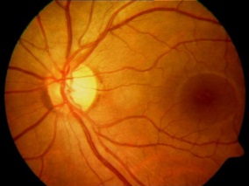
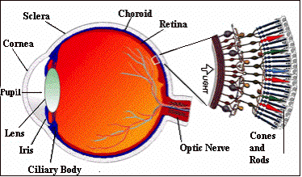
When cornea & lens refract light, an upside down image forms on retina = Layer of cells that lines the inside of eyeball
Made up of tiny, light-sensitive cells called rods & cones
Rods – cells that contain a pigment that responds to small amounts of light
All to see dim light (black, white, shades of gray)
Cones – cells that respond to color
May detect red, green or blue light
Respond best in bright light
Rods & cones help change images on retina into signals that travel to brain

Slide 9
A Signal Goes to the Brain
Rods & Cones send signals to brain along short, thick nerve called the optic nerve
Begins at blind spot (area of retina that has no rods or cones)
Brain interprets signals as an upright image
Combines images from each eye into a single 3-dimensional image

Slide 10
