Slide 1
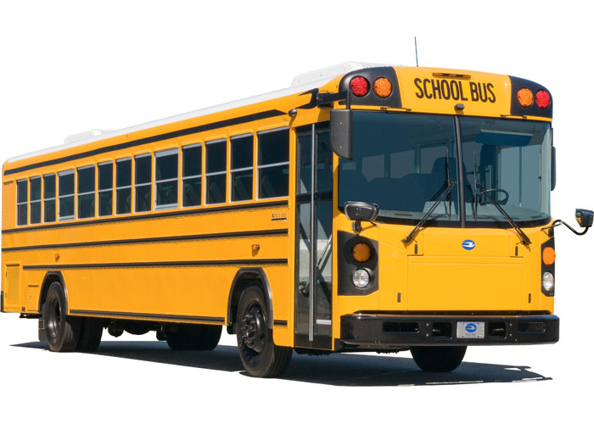
Afternoon Dismissal
Ligon GT Magnet Middle School

Slide 2
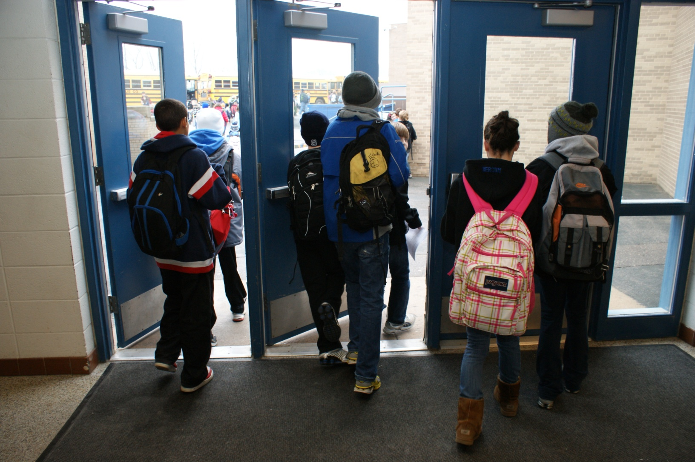
LISTEN FOR INSTRUCTIONS
At the end of the school day, following afternoon announcements, students will be dismissed from school.

Slide 3
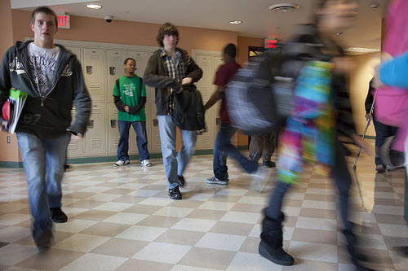
LISTEN FOR INSTRUCTIONS
In preparation for dismissal, students should have their backpacks, instruments, and materials with them during seventh period. Students are not to access their lockers after school.

Slide 4
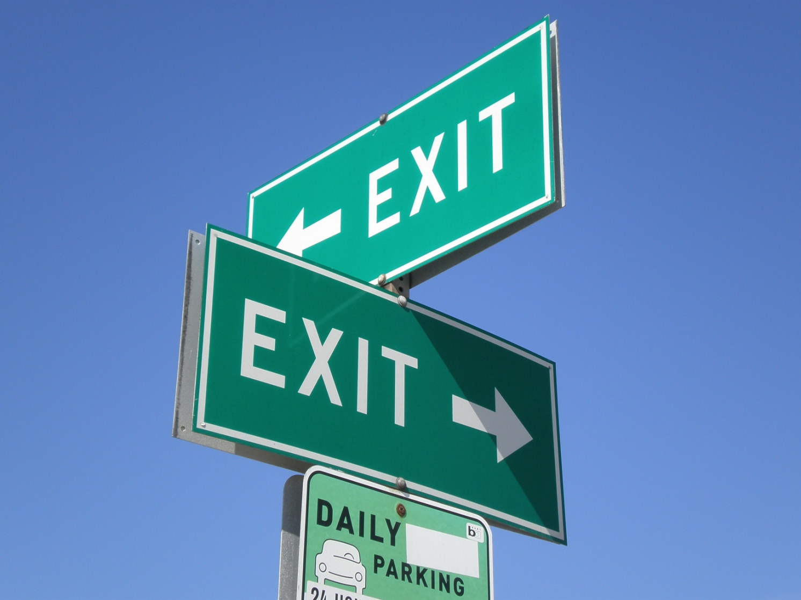
LISTEN FOR INSTRUCTIONS
Once dismissed, students should exit the building in an orderly manner. Students may not re-enter the building once outside.

Slide 5
LISTEN FOR INSTRUCTIONS
Students walking home are to exit the building and immediately leave campus.

Slide 6
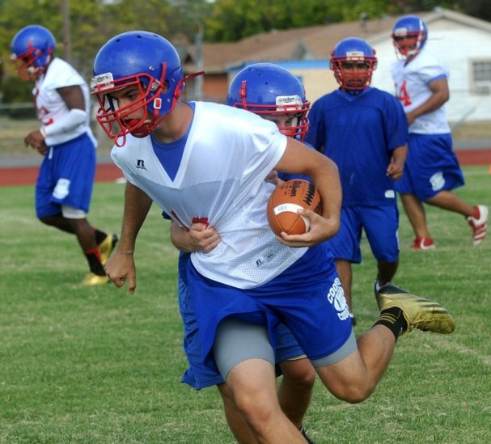
LISTEN FOR INSTRUCTIONS
Students with after school activities on campus should report to the activity promptly.

Slide 7
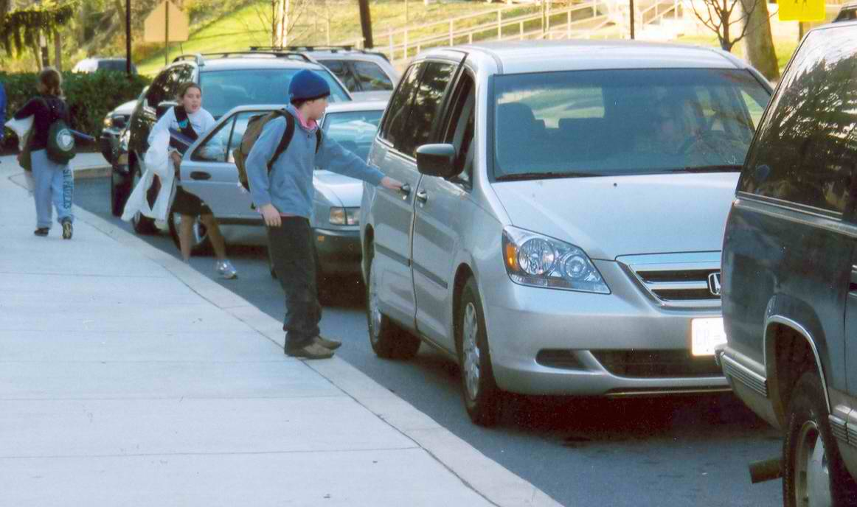
Carpool students will wait for their ride on the sidewalk outside the main entrance.

Slide 8
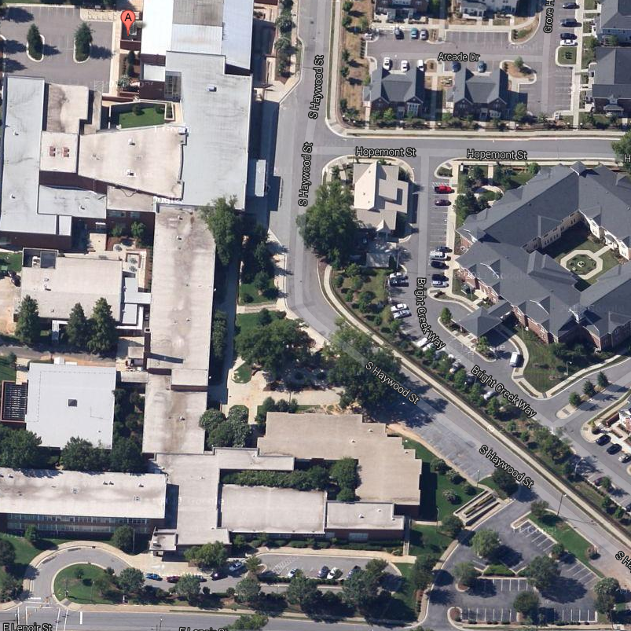
Students taking a bus home will wait on the sidewalk along Haywood Street. Make sure you know your bus stop location.

Slide 9
LISTEN FOR INSTRUCTIONS
Only approach the bus after it comes to a complete stop. Pushing, shoving, or horseplay is not appropriate while getting on the bus or during the trip home.

Slide 10
Dismissal Tips
Your safety is our number one priority. Running and horseplaying isn’t allowed.
While talking with friends is allowed, running around or visiting friends in another area is not. We don’t want you to miss your ride.
Keep track of your jacket, instrument, and backpack at all times.
Walk on walkways only. Students should not walk in the street or through planted areas.
We like our trees, plants and flowers at Ligon. Please enjoy them from a distance.
LISTEN FOR INSTRUCTIONS

Slide 11
Remember
In preparation for dismissal, students should have their backpacks, instruments, and materials with them during seventh period.
Once dismissed, students should exit the building in an orderly manner.
Walkers should exit the building and immediately leave campus.
Students with after school activities on campus should report to the activity promptly
Carpoolers should wait for their ride on the sidewalk outside the main entrance.
Bus students should wait on the sidewalk along Haywood Street. Make sure you know your bus stop location.
Only approach the bus after it comes to a complete stop.
LISTEN FOR INSTRUCTIONS

