Slide 1
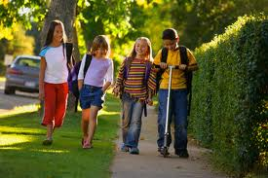
Morning Arrival
Ligon GT Magnet Middle School

Slide 2
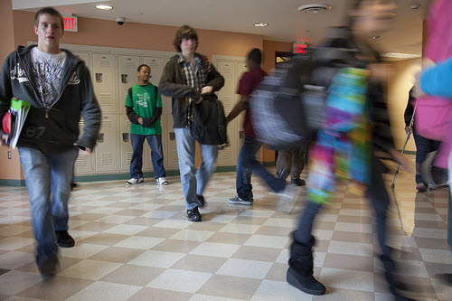
LISTEN FOR INSTRUCTIONS
Students arriving to school before 7:23 AM, when the first bell rings, should report to the gymnasium, media center, or cafeteria. Students are not allowed to go to their lockers or classrooms until 7:23 AM.

Slide 3
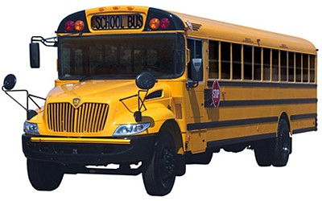
LISTEN FOR INSTRUCTIONS
No matter how you get to school, if you arrive before 7:23 AM you should follow the correct routes to the gym, media center, or cafeteria.

Slide 4
LISTEN FOR INSTRUCTIONS
Once you enter the building any electronic devices should be turned off and put away for the school day.

Slide 5
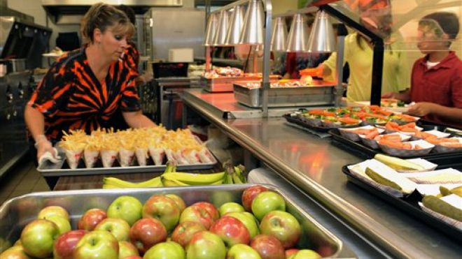
LISTEN FOR INSTRUCTIONS
Students planning on purchasing breakfast should walk to the cafeteria.

Slide 6
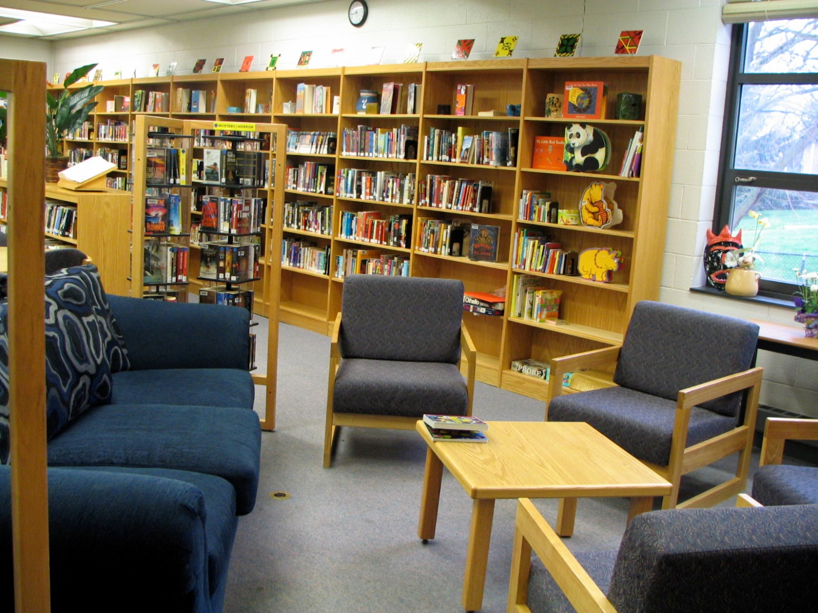
LISTEN FOR INSTRUCTIONS
Students wanting to read, work on an assignment, or research, should report to the media center.

Slide 7
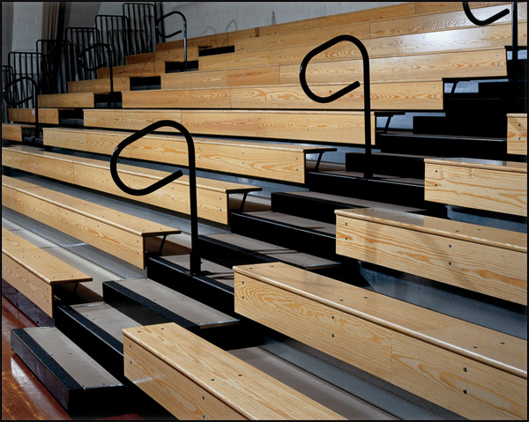
LISTEN FOR INSTRUCTIONS
All other students should report to the school gymnasium and take a seat on the bleachers.

Slide 8
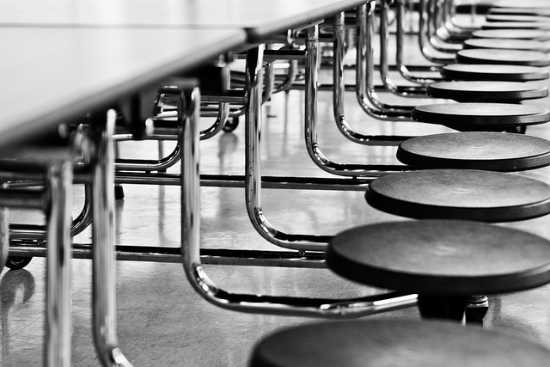
LISTEN FOR INSTRUCTIONS
No matter where you choose to go, you must remain seated.

Slide 9
LISTEN FOR INSTRUCTIONS
Food, drinks, and gum are not allowed in the media center or gym.

Slide 10
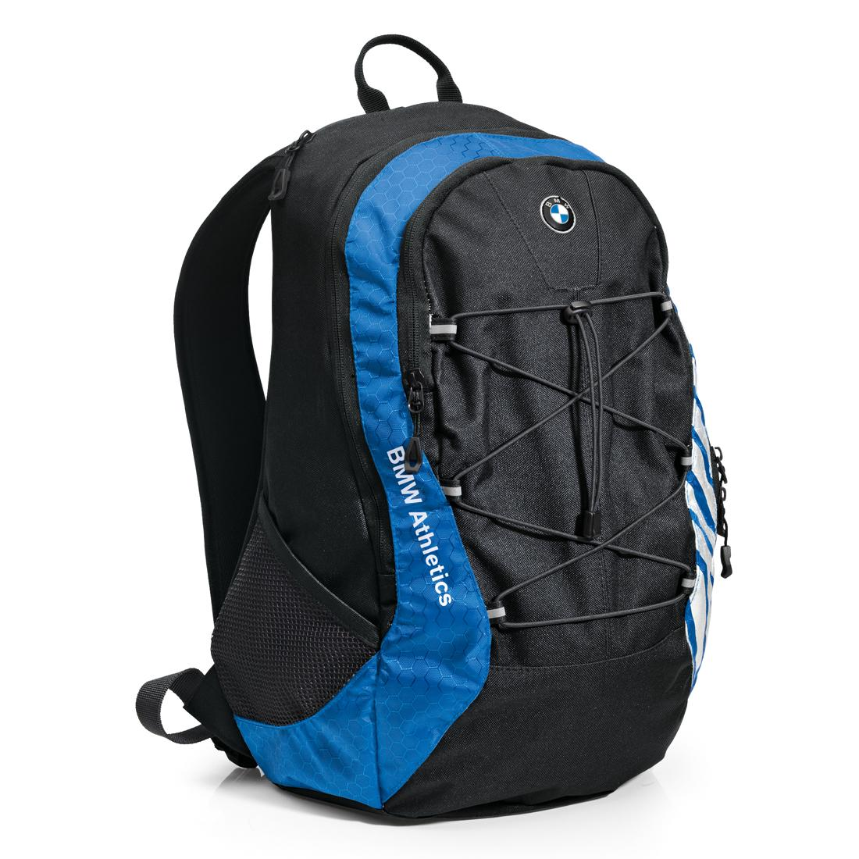
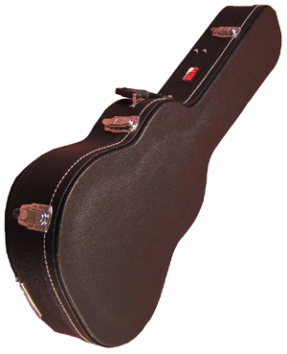
LISTEN FOR INSTRUCTIONS
Keep your book bag, instrument, and any personal belongings beside you at all times. Remember to take them with you when you leave.

Slide 11
Respond Appropriately to Adult Requests
No matter the situation or location, all students are expected to:
Stop moving when instructed by an adult.
Listen to the adult.
Be respectful by making eye contact and refraining from shrugging, rolling eyes, or muttering.
Remain in place until the adult dismisses you.

Slide 12
Have a Great Day!
LISTEN FOR INSTRUCTIONS

Slide 13
Remember
Students arriving to school before 7:23 AM should report to the gymnasium, media center, or cafeteria.
Once you enter the building any electronic devices should be turned off and put away for the school day.
Students planning on purchasing breakfast should walk to the cafeteria.
Students wanting to read, work on an assignment, or research, should report to the media center.
All other students should report to the school gymnasium and take a seat on the bleachers.
No matter where you choose to go, you must remain seated.
Food, drinks, and gum are not allowed in the media center or gym.
Keep your belongings with you.
Be respectful and follow all staff instructions.
Have a great day!
LISTEN FOR INSTRUCTIONS

