Slide 1
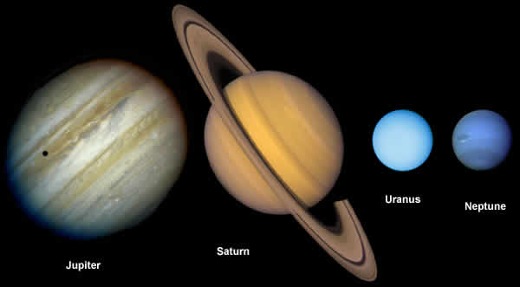
Outer Planets
A.K.A.
Gas Giants

Slide 2
Label your foldable as shown below:
Jupiter
Saturn
Uranus
Neptune

Slide 3
Write your information for Jupiter in this box on your foldable:

Slide 4
Jupiter
First gaseous planet; rocky core . 3 rings, 62 moons
Large atmosphere, made up mostly of helium (He) and Hydrogen (H) just like the sun. It with clouds of Ammonia (NH₃) .
Surface temperatures around -145º C (-244º F)
Gravity 2.4 times that of Earth
Windy planet, with wind speeds up to 400 mph.
May be water on some of Jupiter’s moons.

Slide 5
Write your information for Saturn in this box on your foldable:

Slide 6
Saturn
Second largest planet in our solar system and the sixth planet from the sun
Has at least 62 moons, the largest is Titan
Has many rings that are made of rock and ice particles
About 750 Earth’s could fit into Saturn without bumping into its rings
Water-ice is only found as small particles within the rings
Atmosphere is 96.3% Hydrogen and 3.25% Helium and small percentages of other gases such as ammonia and methane
Average temperature is -177°C (-285°F)

Slide 7
Write your information for Uranus in this box on your foldable:

Slide 8
Uranus
80 % or more of the mass made of a hot dense fluid of "icy" materials (water (H₂O), methane (CH₄). and ammonia (NH₃)), above a small rocky core
Atmosphere made of hydrogen (H₂), helium (He), and methane (CH₄)
ammonia and methane ice crystals make up the cloud composition
wind speeds range from 90 to 360 mph
average temperature is a frigid -353^{O} F
does not radiate more heat than it receives. This suggests that the planet may have a cold interior, lacking an internal heat source

Slide 9
Write your information for Neptune in this box on your foldable:

Slide 10
Neptune
Fourth gaseous planet; rocky core . 6 rings, 13 moons
Large atmosphere, made up mostly of helium (He) and Hydrogen (H), water (H₂O), Ammonia (NH₃) and methane (CH₄) .
Surface temperatures around -225º C (-373º F)
Gravity 1.19 times that of Earth
Voyager 2 is the only space craft to visit Neptune.
Sometimes its orbit is further away from the sun than Pluto’s orbit.

