Slide 1
Matter, Elements, & Atoms

Slide 2
Objective 6.P.2.1
all matter is made up of atoms
Atoms of the same element are all alike
Atoms of different elements are not the same

Slide 3
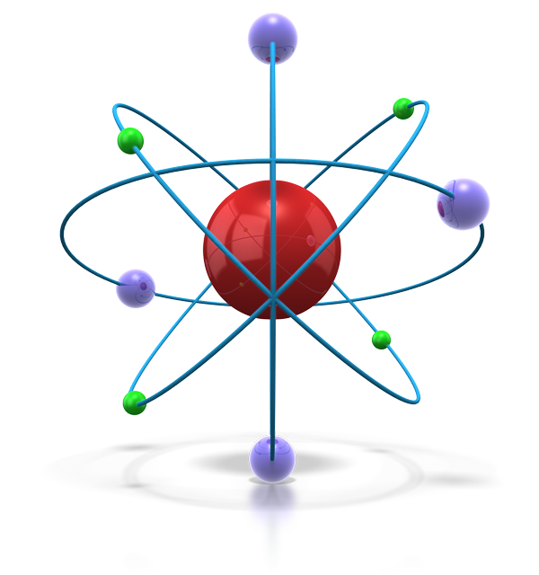
Matter
Matter is anything that has mass and volume.
Mass is the amount of matter in a given object
Volume is how much space an object takes up
The universe is full of matter.

Slide 4
Matter is composed of extremely small particles called atoms.
These particles are too small to be seen without a microscope.
Atoms have all the properties of matter: mass and volume

Slide 5
Elements
Atoms are the smallest part of an element.
All atoms of the same element have the same properties.

Slide 6
Matter is made of elements.
There are more than 100 elements that combine to make up all living and nonliving things.
Elements are shown on a Periodic Table.

