Slide 1
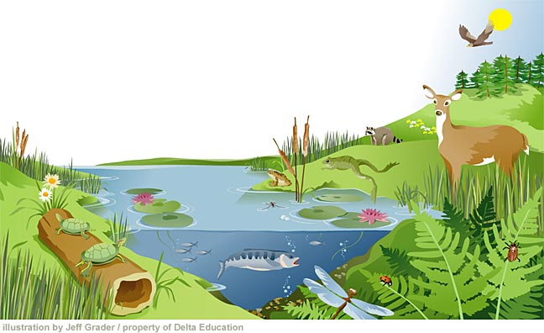
An Introduction To Ecosystems

Slide 2
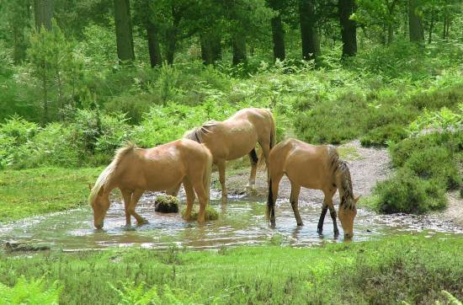
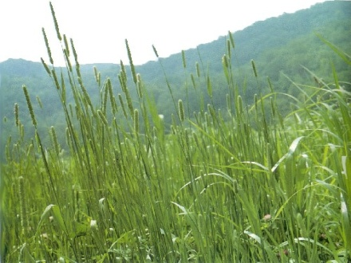
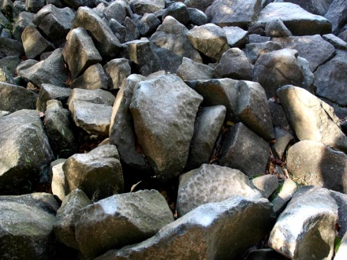
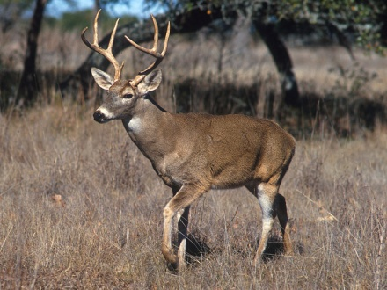
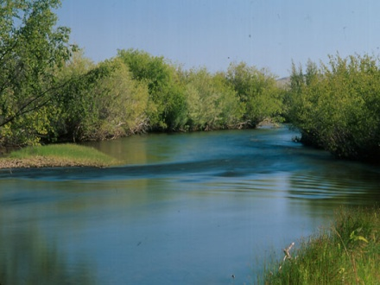
Ecology: the study of ecosystems.
Ecosystem: all the living and non-living things interacting in an environment.
It consists of 2 main things:
Biotic Factors (living)
Abiotic Factors(nonliving)

Slide 3
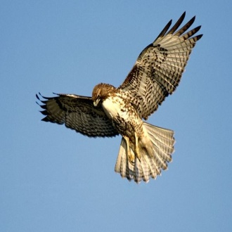
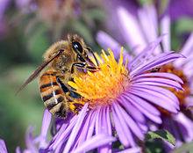
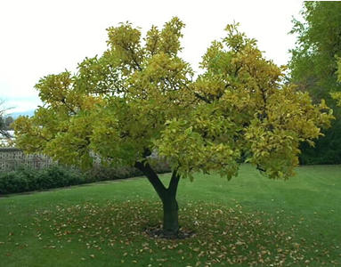
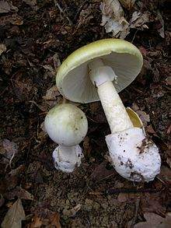
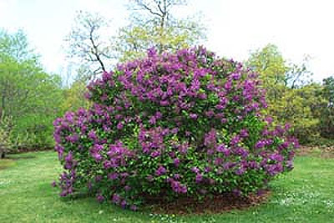
Biotic Factors:
1. Animals
2. Plants
3. Trees
4. Bacteria
5. Insects
6. Fungi

Slide 4
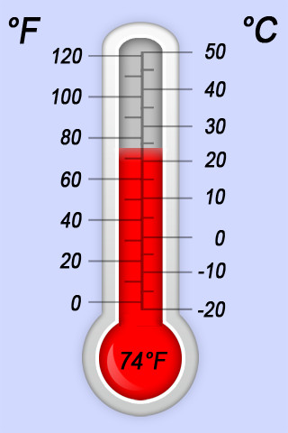
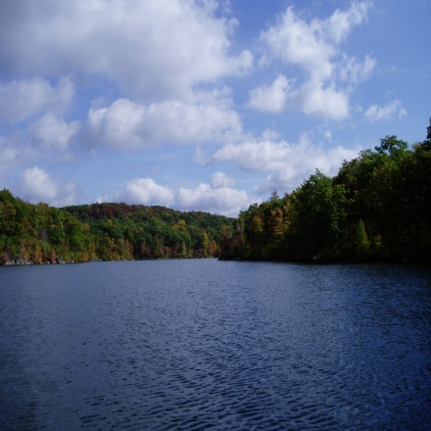
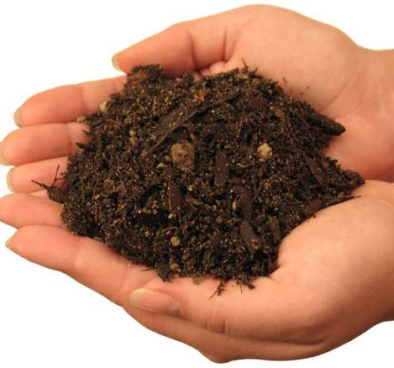
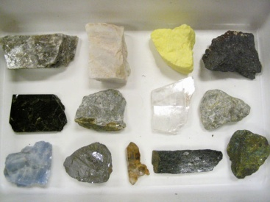
Abiotic Factors:
1. Air
2. Water
3. Soil
4. Sunlight
5. Temperature
6. Rocks
7. Minerals

Slide 5
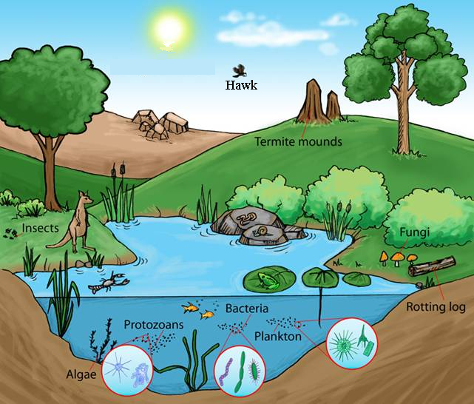
See if you can find the biotic and abiotic factors in this ecosystem. Write them down in your notes:

Slide 6
What is in an ecosystem?
Let’s Take A Look!

Slide 7
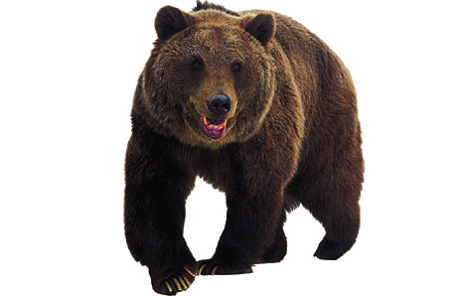
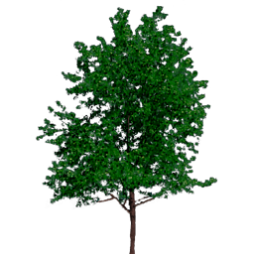
Organism
This is another name for a living thing.
It could be an animal
It could be a plant

Slide 8
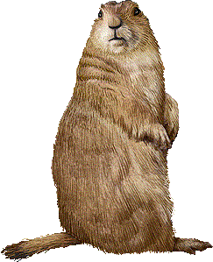
Species
A group of organisms that are the same.
The prairie dog is one example of a species of organisms.

Slide 9
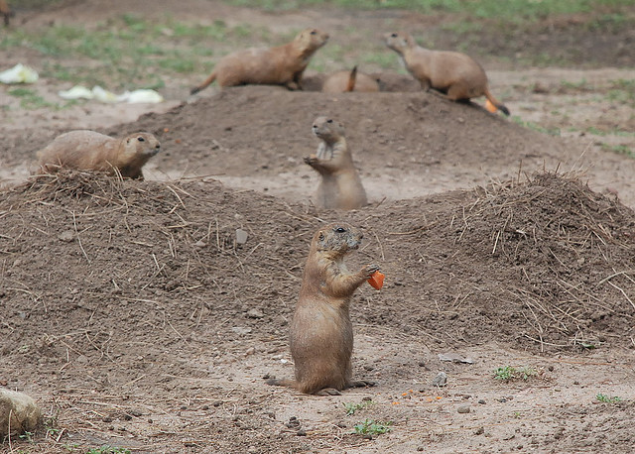
Population
This is all of the members of one species in a particular area.
The hundreds of prairie dogs on the plains of Texas are one example of a population.

Slide 10
Community
A particular area usually contains more than one species of organism.
All the different populations that live together in an area make up a community.
The prairie includes prairie dogs, hawks, grasses, badgers, and snakes, along with many other organisms.

Slide 11
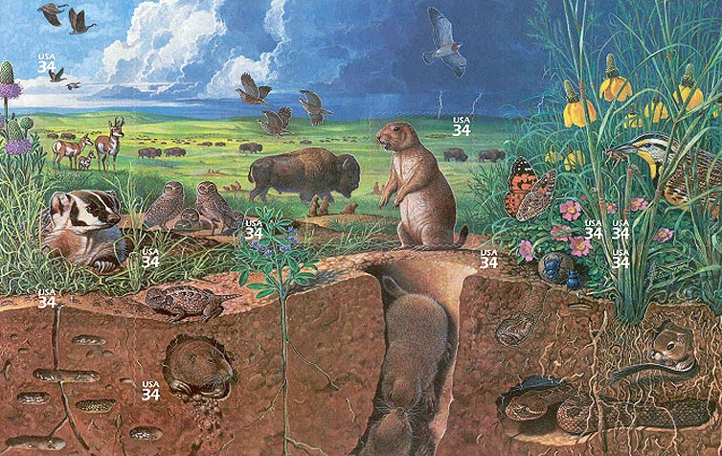
Ecosystem
This is made up of 2 things:
The
community of
organisms that
live in an area.
2. All the
non-living
surroundings.

Slide 12
What are the different energy roles in an ecosystem?
Let’s Take A Look!

Slide 13
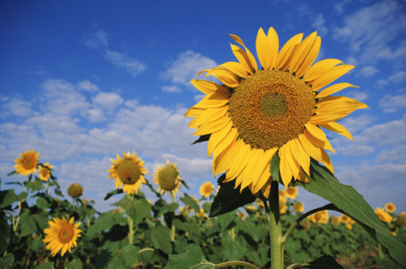
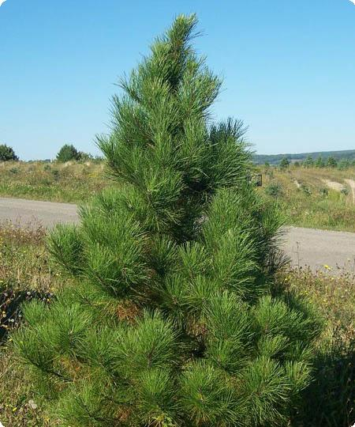
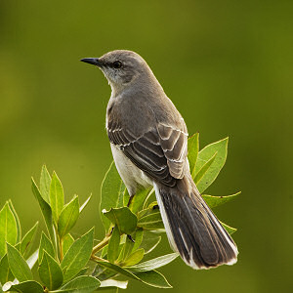
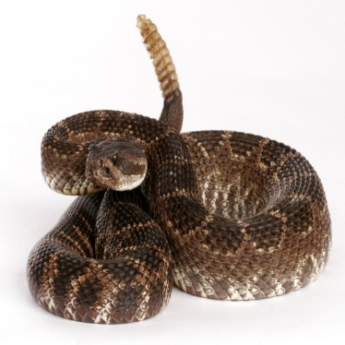
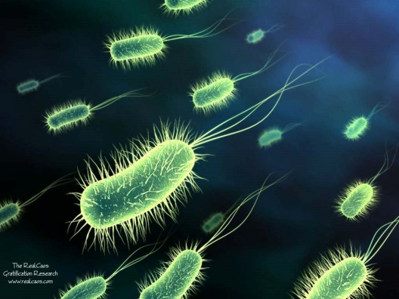
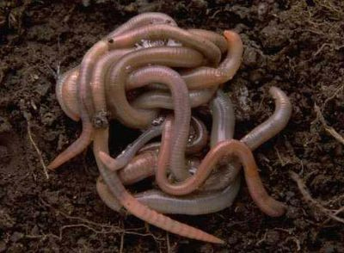
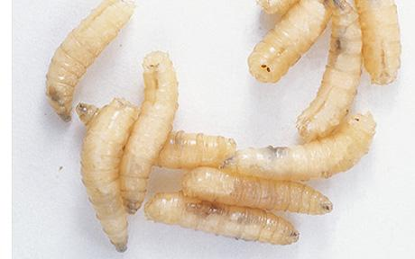
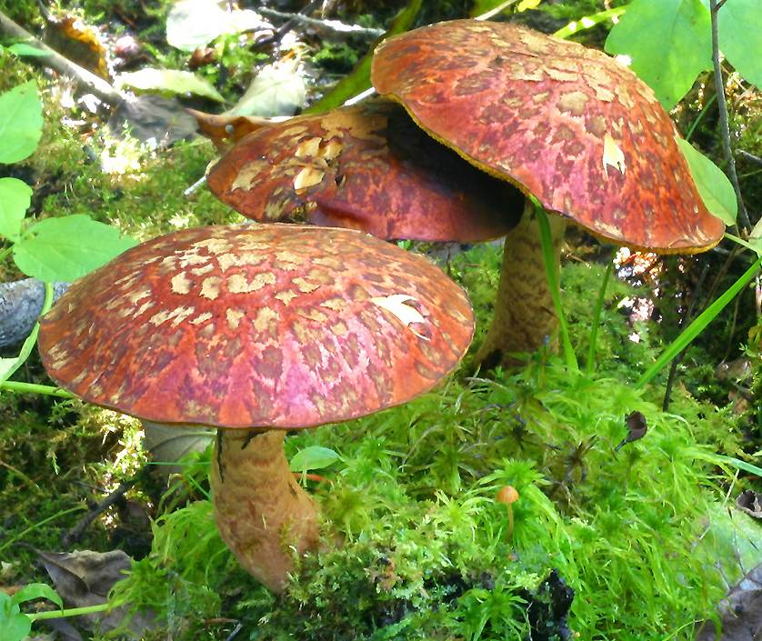
PRODUCERS:
Are organisms that
make their own food
CONSUMERS:
Are organisms that feed
on other organisms
DECOMPOSERS:
Are organisms that
break down wastes and
dead organisms and
return nutrients back
into the ecosystem

Slide 14
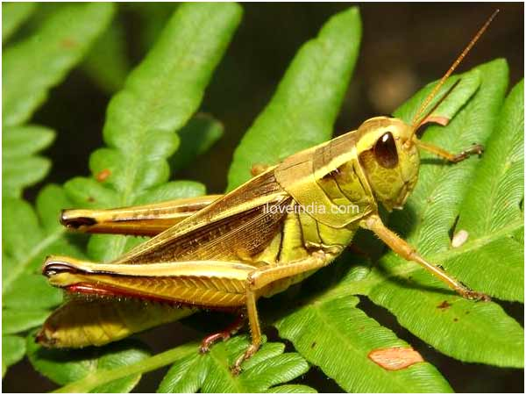
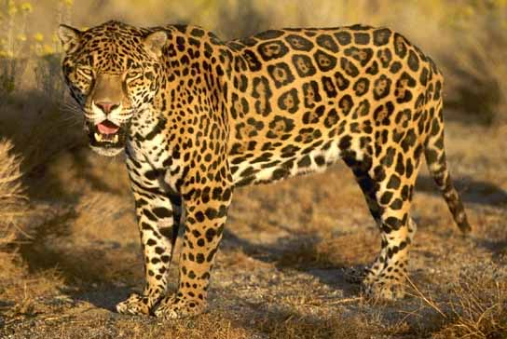
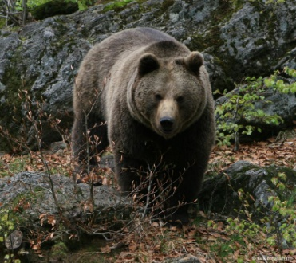
Consumers can be broken into 3 groups:
Herbivores: eat plants.
Carnivores: eat animals.
Omnivores: eat both plants and animals.

