Slide 1
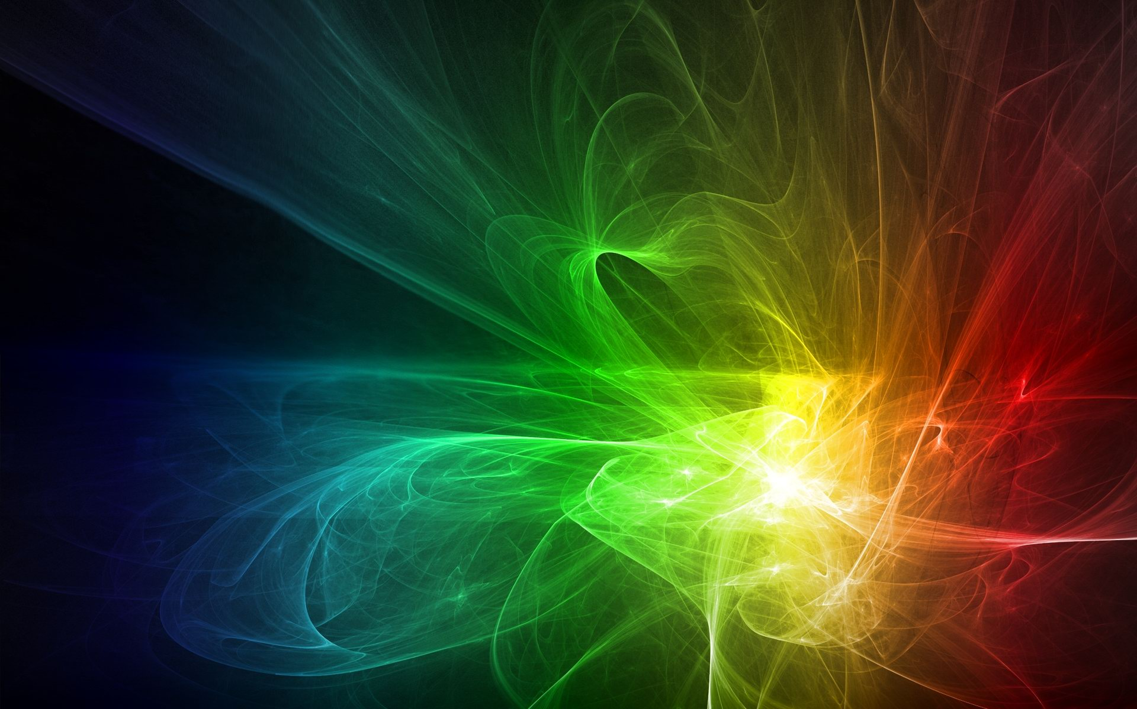
Electromagnetic Spectrum

Slide 2
What does the term spectrum mean?
the range of wavelengths of electromagnetic waves

Slide 3
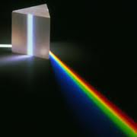
Light Prisms
These are a tool that use refraction to spread out the different wavelengths which make up white light

Slide 4
White Light
White light is all the colors of visible light combined together
This diagram demonstrates white light entering a prism and separating all the colors of light.

Slide 5
Colors of Light
Each wavelength creates a different color
This means that each color of light bends at a different angle
Two factors determine the color of an object:
Wavelengths that the
object reflects/absorbs
-- Wavelengths present
in light that shines on
object

Slide 6
Remember the Primary Colors of Light
Red
Green
Blue

Slide 7
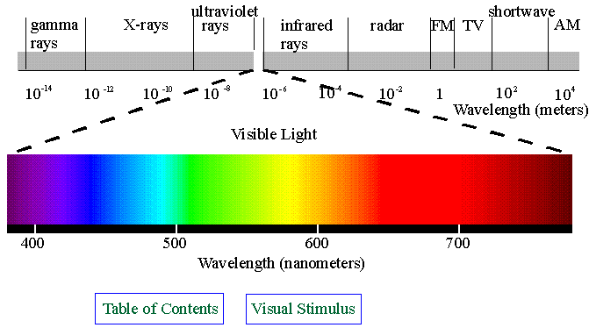
Electromagnetic Spectrum
The range of all electromagnetic frequencies
Usually represented in a diagram

Slide 8
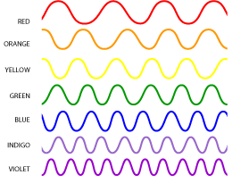
Visible Light
The part of the electromagnetic spectrum that human eyes can see
Longest wavelengths are red and the shortest are violet

Slide 9
ROY G BIV
The 7 colors of visible light are
Red
Orange
Yellow
Green
Blue
Indigo
Violet

Slide 10
Reflection & Absorption
Visible light can either be reflected or absorbed
If it is reflected then the wave bounces back after striking the object
If it is absorbed then
the wave is taken in
by the object and
its energy is changed
to something new

